Slide 1
Ensembl Funcgen: A Database and API for Epigenomics and Gene Regulation Data.
The Ensembl regulation resources
Notes:
1

Slide 2
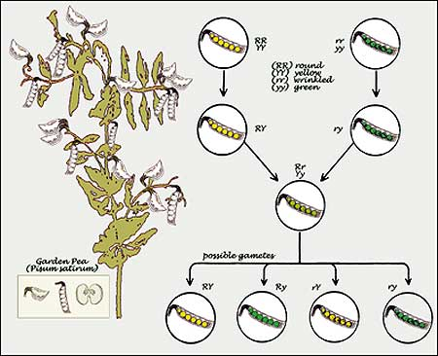
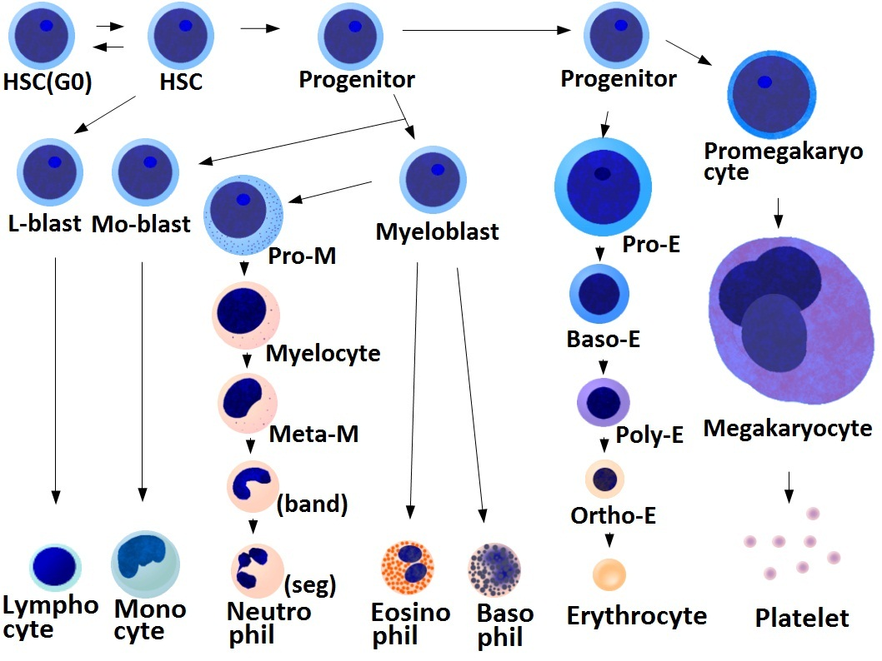
Why annotate non-coding regions?
Genetic Differences
Epigenetic Differences
HHMI.org
Wikipedia.org
Notes:
Left: Differences in the genome sequence lead to different traits in the cells.
Right: All cells have the same genome, but different set of genes are active.
2

Slide 3
Course materials
http://www.ebi.ac.uk/~mnuhn/api_course/

Slide 4
Workshop Overview
Background
Data Sources
Regulatory Build
API
Data Classes
Features:
Regulatory
Annotated
Segmentation
Sets
Motifs
ExternalFeatures
Notes:
You can find all slides in PowerPoint and PDF format at this URL, also exercises, solutions and links to different resources. [Give a couple of minutes if needed]
First I will give a brief overview about the biology important to the content of Ensembl Regulation. This is likely more than previous trainers do and based on feedback of past courses. The Regulation part of the API is usually regarded as the most intense one. Next I will introduce you to our largest data sources, followed about an overview of our RegulatoryBuild. The final outcome of the build is the Regulation [FuncGen] database, which serves as a source for the API, Ensembl website and tools like BioMart or the VEP.
Now we will look at a subsection of the API, mainly Data classes, Regulatory and Annotated Features, and what we understand as Sets.
4

Slide 5
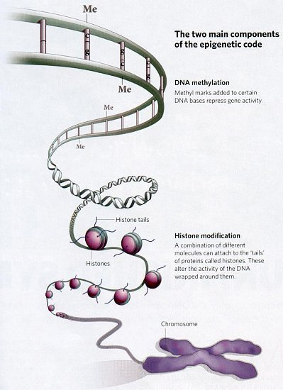
Epigenetics
“The study of cellular and physiological phenotypic trait variations that result from external or environmental factors that switch genes on and off and affect how cells express genes.”
https://en.wikipedia.org/wiki/Epigenetics
http://integratedhealthcare.eu/
Notes:
Question: Who knows about epigentics? Which parts have you worked in?
In the Variation module yesterday you talked about the differences of a genomic sequence to the reference genome. Tomorrow in the compara module you will talk about the differences (or similarities) of genes, proteins or genomes of different species.
In Regulation we study of heritable changes in gene activity, usually between cell types, without changes in the DNA sequence. The changes happen "above" the gene level, therefore the more commonly known name is Epigenetics/Epigenomics.
5

Slide 6
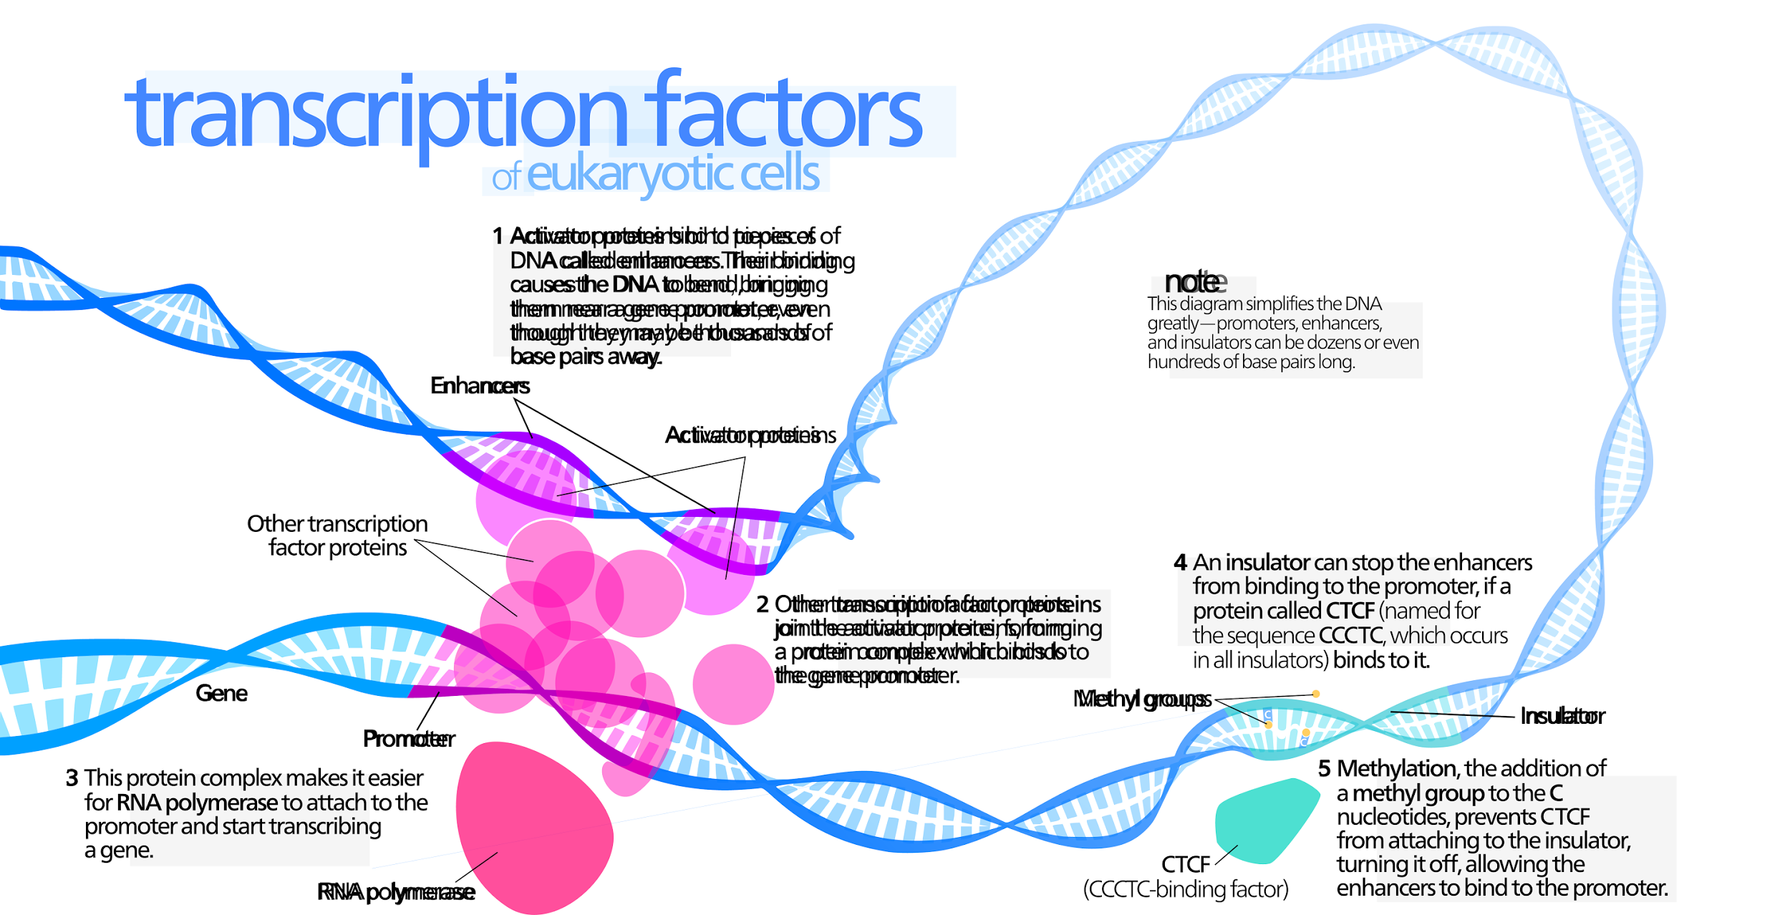
Transcriptional regulation elements
Enhancers
Activator proteins
Methyl groups
Promoter
Insulator
RNA Polymerase
"Transcription Factors" by Kelvinsong - Own work
https://commons.wikimedia.org/wiki/File:Transcription_Factors.svg#/media/File:Transcription_Factors.svg
Notes:
MK to insert slide on epigenetics

Slide 7
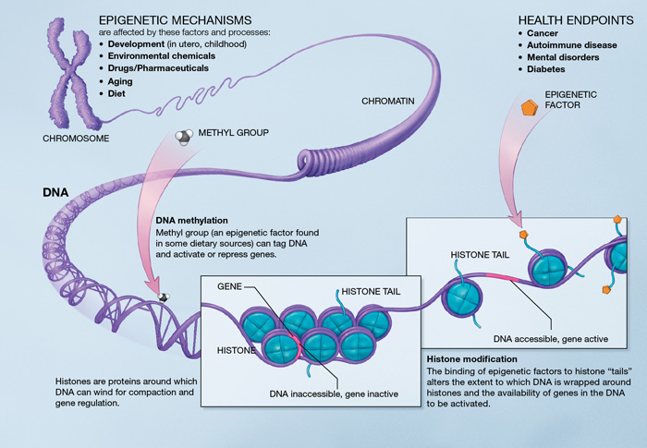
Epigenetics
DNA methylation
Open chromatin
Nucleosome positioning
Histone tails modifications
3D conformation
Image taken from: http://commonfund.nih.gov/epigenomics/figure
Notes:
These mechanisms together with TFs and chromatin remodelling factors can establish unique epigenetic states resulting in alterations of gene expression that for example can determine cellular diversity with virtually no differences in DNA sequences.

Slide 8
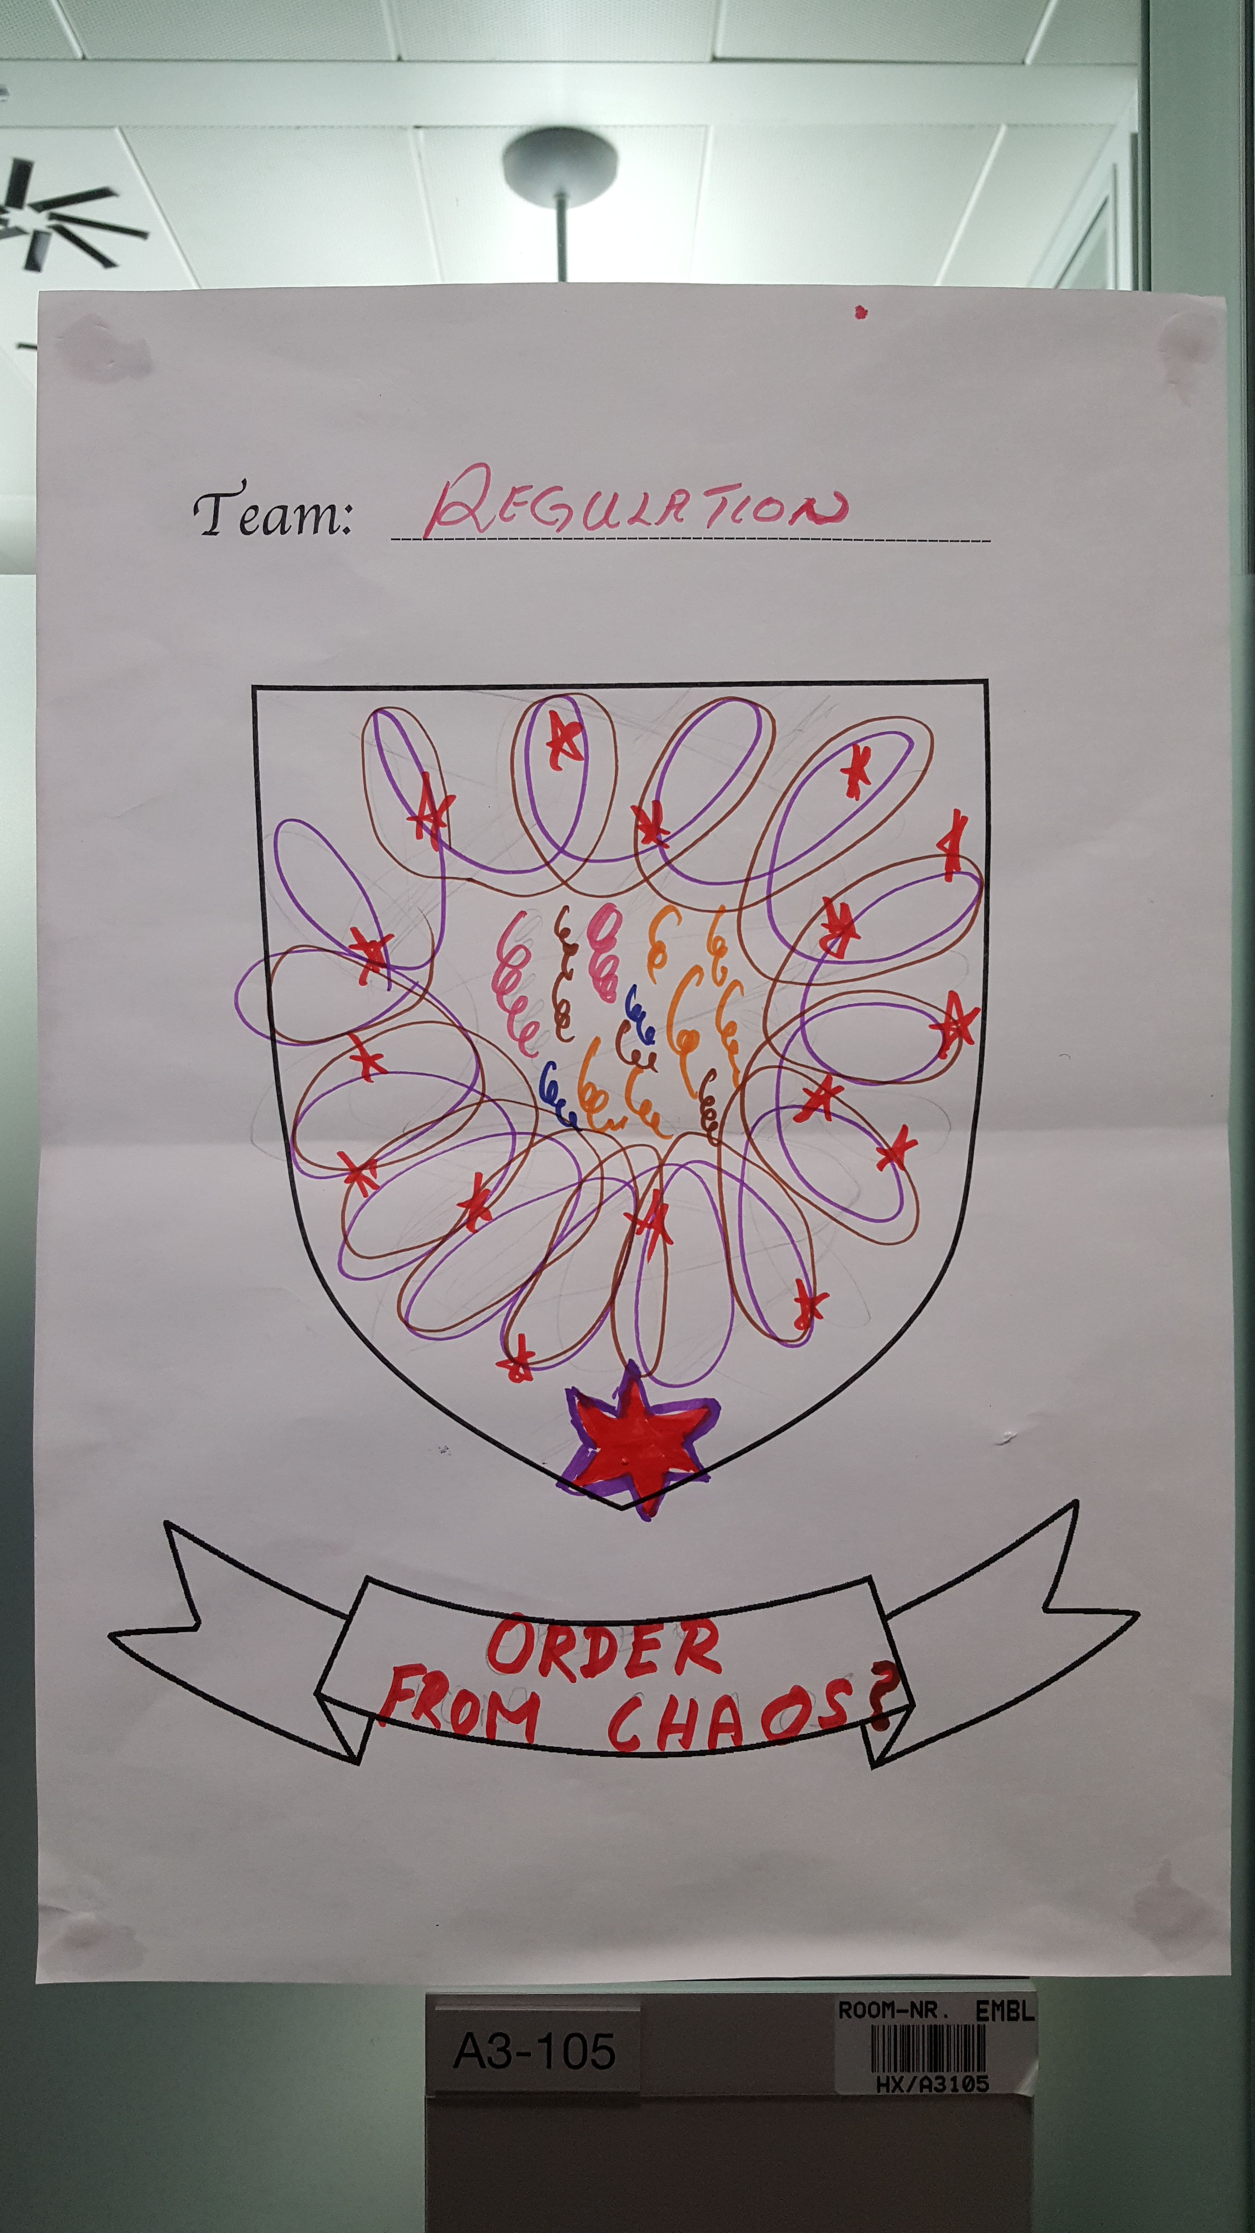
Ensembl Regulation
The goal of Ensembl Regulation team is to annotate the genome with features that may play a role in regulation of gene expression.
Predicted open/closed chromatin
DNase I sensitivity
Transcription factor binding sites
Epigenetic marks
Histone modifications
DNA methylation

Slide 9
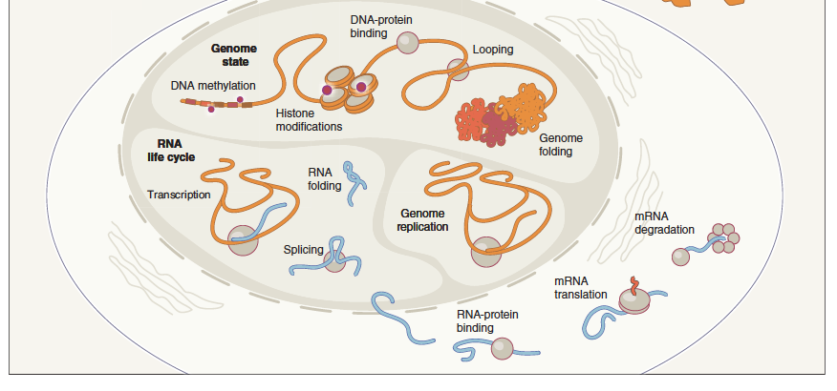
Epigenomic and Transcriptomic Assays
ChIP-seq
(promoter capture) HiC
ChIA-PET
WGB-seq
RNA-seq
Shendure J. et al., Nat Biotechnol. 2012 Nov;30(11):1084-94
Notes:
The set of high-throughput assays used to interrogate the transcriptome and the epigenome.

Slide 10
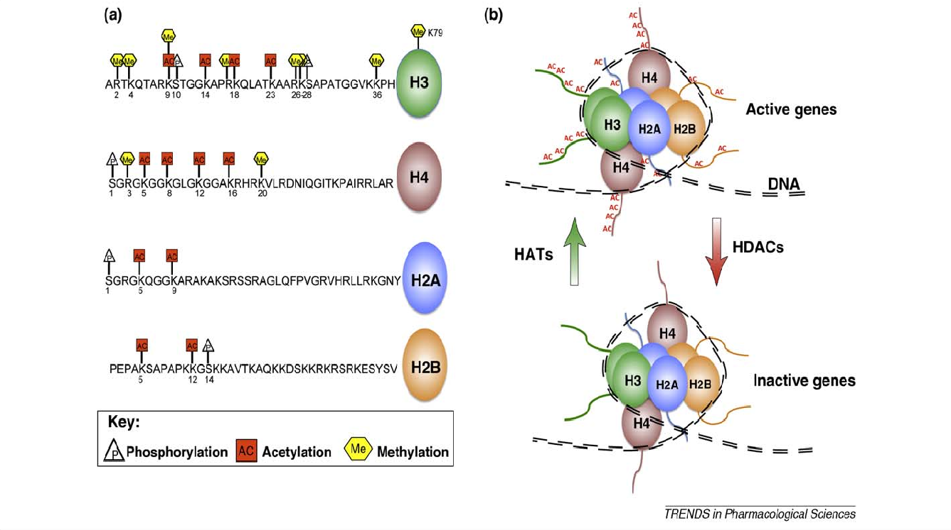
Histone modifications
André Fischer et. al, Cell 2010, 31:605-617
Notes:
Mention example of H3K27ac, because this is used in the wiggletools exercises.

Slide 11
Histone modifications known role
Mark | Associated activity
H3K4me1 | Enhancers & downstream of promoter
H3K4me2 | Enhancers & promoter
H3K4me3 | Promoter/TSS
H3K9ac | Promoter
H3K9me1 | Associated to transcription, esp. at 5’ end of gene
H3K9me3 | Repressed domains
H3K27ac | Active enhancers and promoters
H3K27me3 | Polycomb repressed
H3K36me3 | Associated to transcription, esp. at 3’ end of gene
H3K79me2 | Associated to transcription, esp. at 5’ end of gene
H4K20me1 | Associated to transcription, esp. at 5’ end of gene

Slide 12
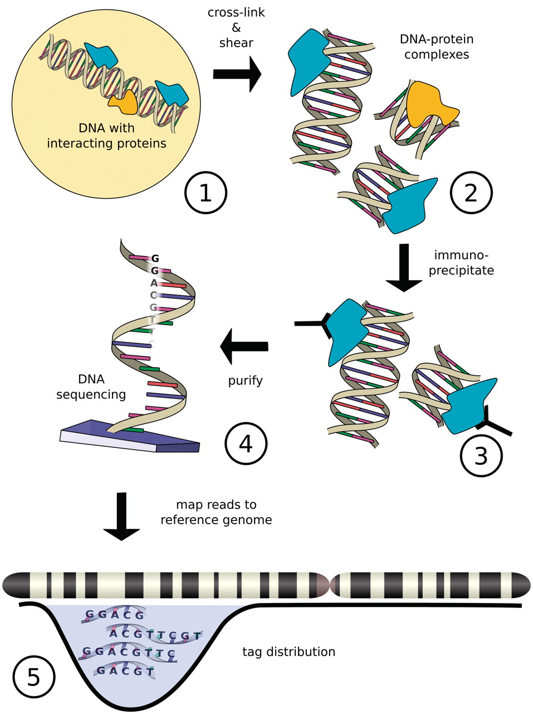
ChIP sequencing (ChIP-seq)
Adam M. Szalkowski, and Christoph D. Schmid Brief Bioinform 2011;12:626-633
Notes:
Workflow of a ChIP-seq analysis: Chromatin in the nucleus (1) is cross-linked and sheared (2), followed by enrichment of complexes containing the target protein using immunoprecipitation (3). Short reads obtained from massively parallel sequencing (4) are mapped to a reference genome (5) yielding in a distribution of tags on the genome (adapted from http://en.wikipedia.org/wiki/File:Chip_sequencing2.png 2008-02-29).
!!!! Not an exact science !!!! Unlike SNPs, we can't pinpoint to one specic position.

Slide 13
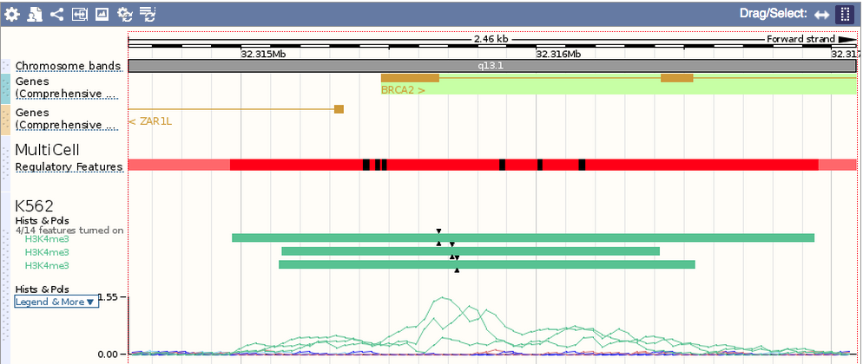
ChIP-seq data sets in Ensembl
Notes:
Tell participants how to find this in the web browser
Add link

Slide 14
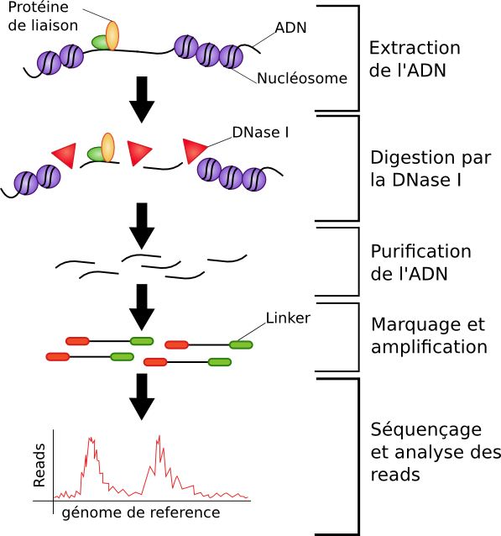
DNaseI sequencing (DNaseI-seq)
TF binding
DNA
extraction
Nuclesome
DNaseI
DNAseI
digestion
DNA
purification
Adapter insertion and amplification
DNA sequencing and
bioinformatic
analysis
Reference genome
Image adapted from: http://bioinfo-fr.net/wp-content/uploads/2013/05/DNase-seq.png

Slide 15
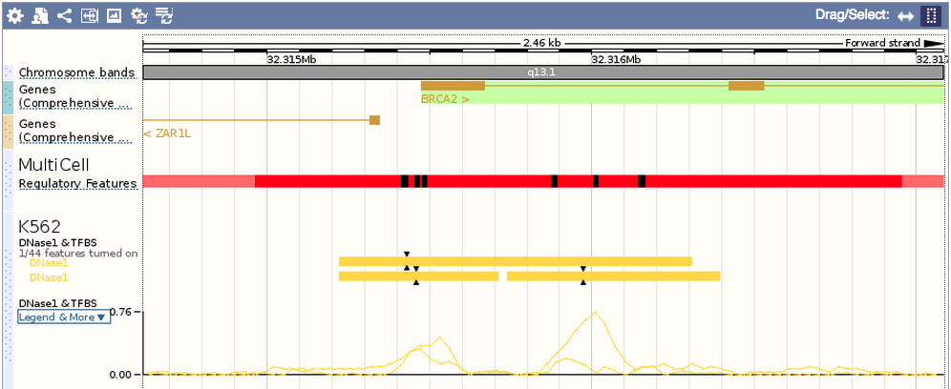
DNaseI-seq data sets in Ensembl
Notes:
Mention fingerprinting here too
The idea is that parts of the chromosome where chromatin is open (histones and DNA separated) are more likely to be active. These sites are identified by digesting them using DNaseI. About 9% of the genome are nucleosome depleted sites across different cell lines.
15

Slide 16
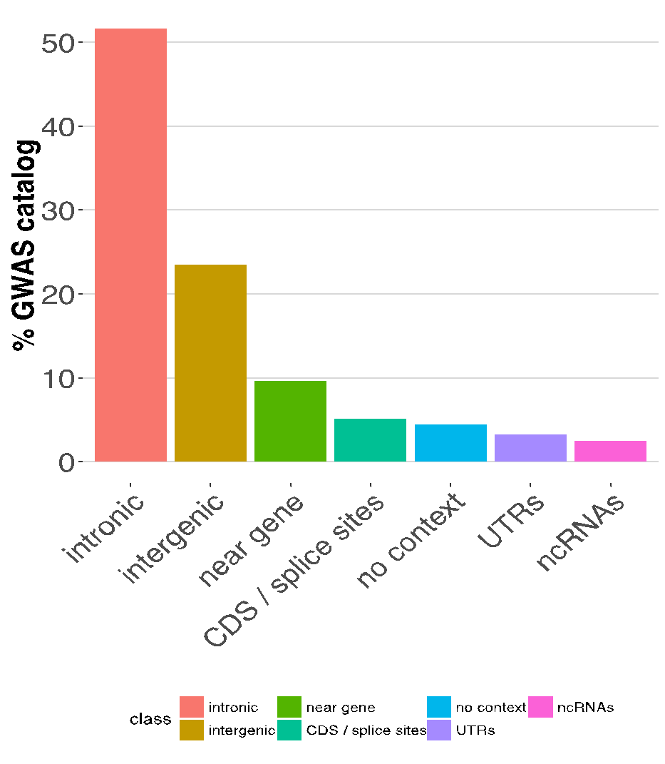
Why annotate non-coding regions?
“(Common) variants associated with diverse human diseases and phenotypic traits are concentrated in regulatory DNA […], implicating regulatory variation as an important mediator of quantitative human phenotypes.” *
*Maurano MT et al., Nature Genet. 2015 Oct 26.
GWAS catalog v1.0 – associations e86 r2016-10-23

Slide 17





Ensembl Regulation data sources
http://www.ensembl.org/info/docs/funcgen/regulation_sources.html
http://www.ensembl.org/Homo_sapiens/Experiment/
Notes:
17

Slide 18
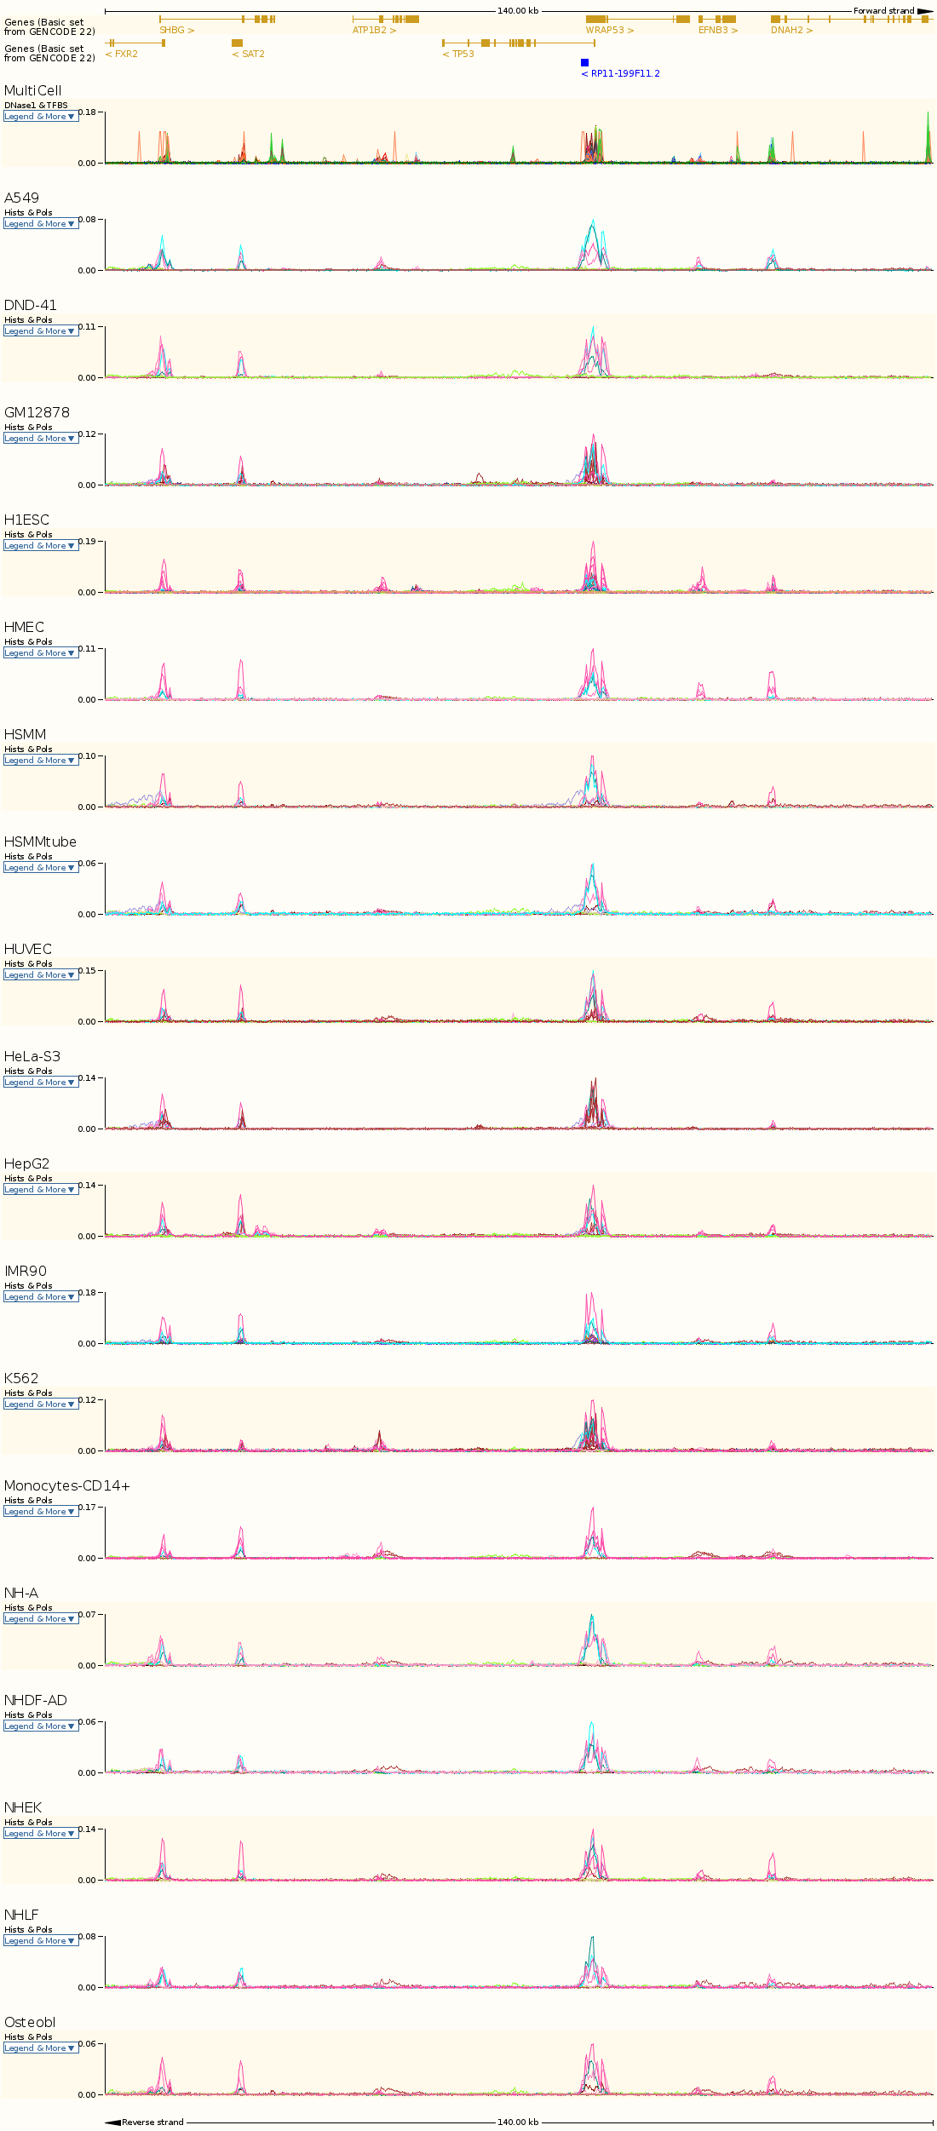
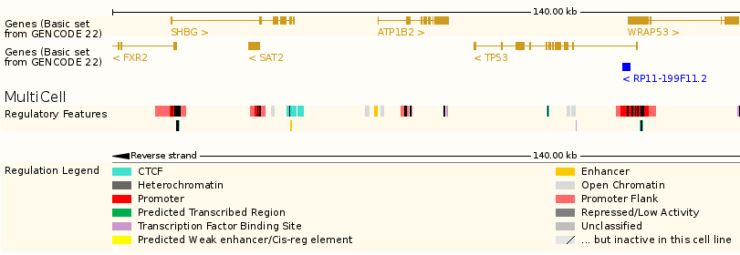
The Ensembl Regulatory Build
~13% of the genome is annotated
Includes cell type activity levels
active / poised / repressed / inactive
Tested against experimentally validated datasets
FANTOM5 and VISTA
Linked to JASPAR TF binding motifs
Now on human and mouse
68 human and 8 mouse cell types & lines
Extension to farmed animals (FAANG)
Integrative analysis
Notes:
Emphasise the assessment of our regulatory build analysis to experimentally validated regulatory elements defined by the FANTOM and VISTA consortia

Slide 19
Regulation Data (e76)
Type | Number | Avg. Length (bp) | S.D. (bp) | Total Length (Mbp) | Genome coverage (%)
Promoters | 16488 | 4369 | 2746 | 72 | 2.3%
Proximal enhancers | 85526 | 1876 | 1741 | 160 | 5.2%
Distal enhancers | 127786 | 547 | 482 | 70 | 2.3%
CTCF binding | 117711 | 622 | 1206 | 73 | 2.4%
Unannotated TFBS | 27523 | 528 | 628 | 15 | 0.5%
Unannotated open chromatin | 71568 | 502 | 346 | 36 | 1.2%
Total | 446602 |  |  | 399 | 12.9%
Notes:
select count(fs.feature_set_id), count(distinct (ft.feature_type_id)), ft.class from feature_type ft, data_set ds, supporting_set ss, feature_set fs where ds.name like "Reg%" and ds.name != 'RegulatoryFeatures:MultiCell' and ds.data_set_id=ss.data_set_id and ss.supporting_set_id=fs.feature_set_id and fs.feature_type_id=ft.feature_type_id group by ft.class;
Only part of ENCODE data present at the moment.
More funding (=data) for human
Compare human and mouse
Check SAB docs
19

Slide 20
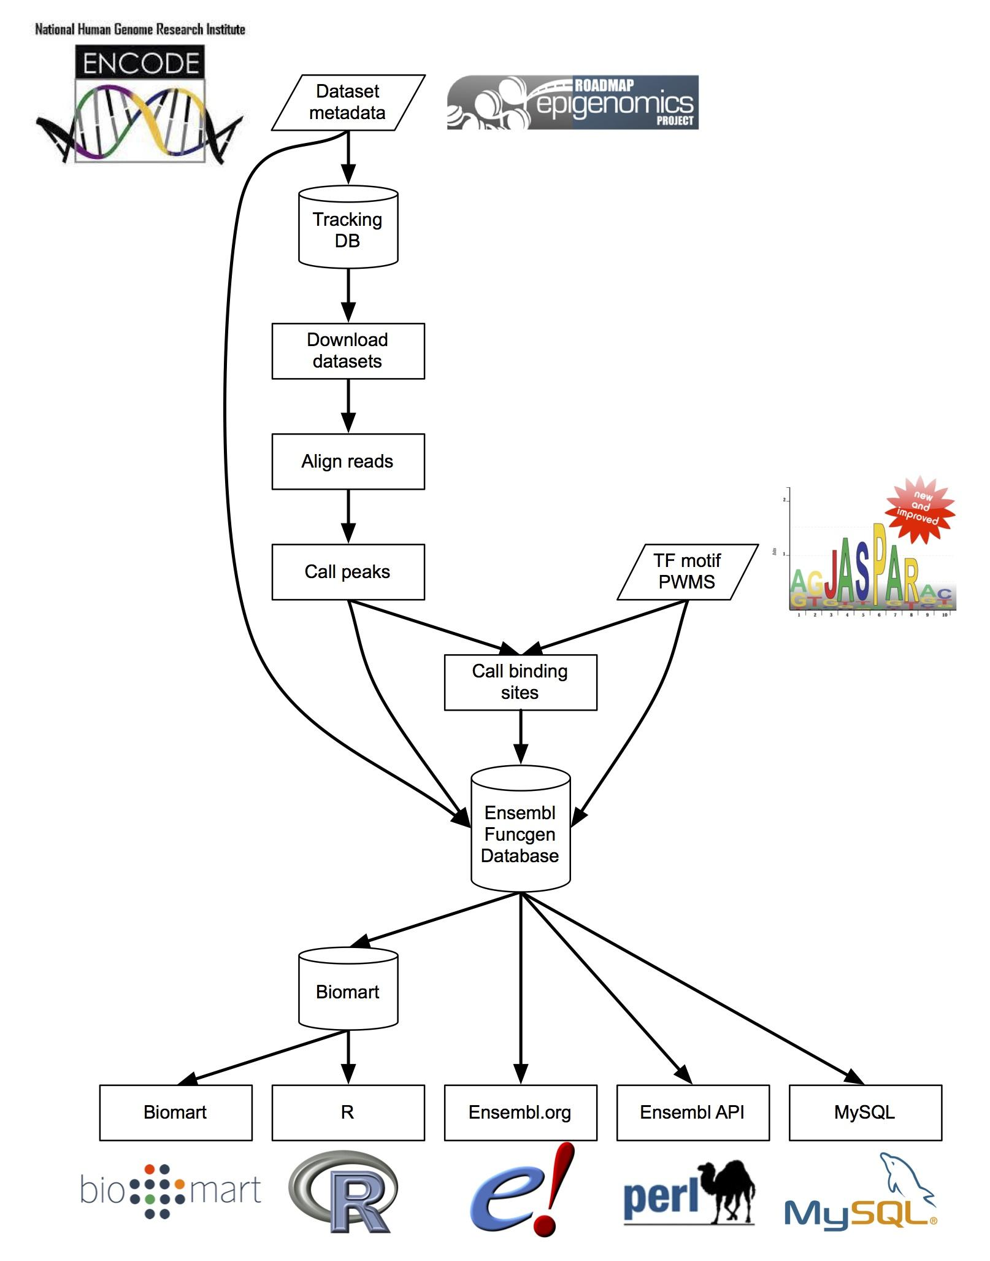
Access to the Ensembl Regulation resources

Slide 21
Notes:
Explain objects here, then exercises

Slide 22
Regulatory Feature exercise
Retrieve all Regulatory Features located in the region 1000bp upstream of the TSS of the 'ESPN' gene.

Slide 23
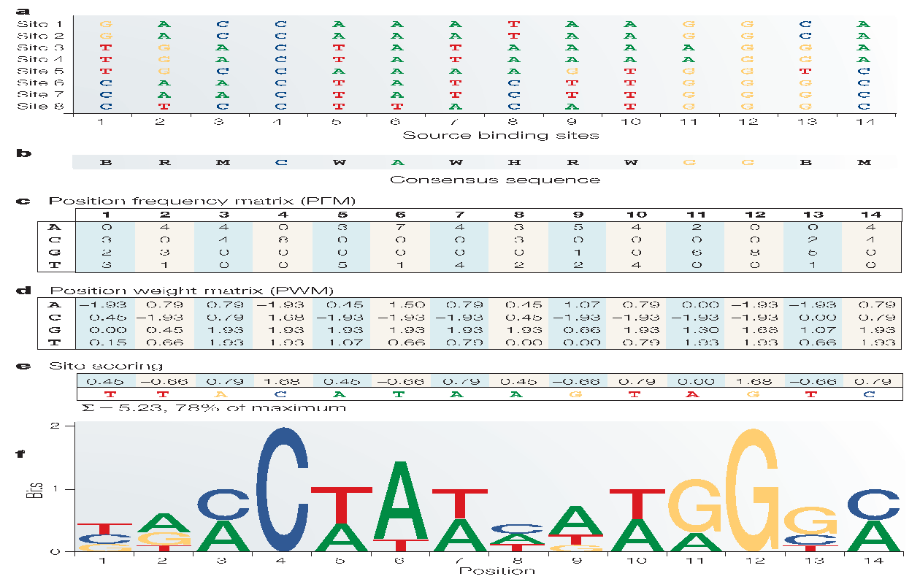
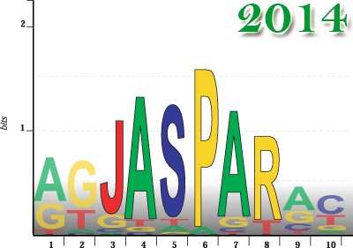
Transcription Factor Binding Motifs
Wassermann and Sandelin, Nature Rev. Genet. 2004, 5:276-287

Slide 24
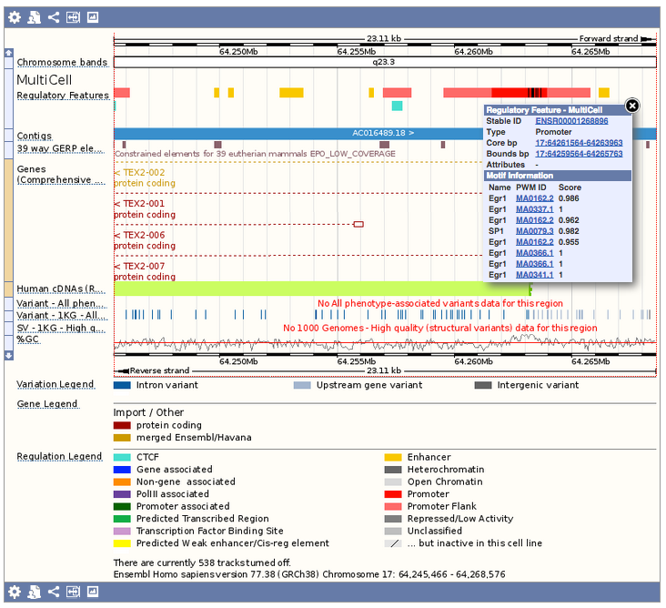
Transcription factor binding sites (TFBS)

Slide 25
Motif Feature & Binding affinity Exercises
Retrieve all Motif Features that have been annotated in the Regulatory Feature with stable id ‘ENSR00000000667’
If the motif sequence changes due to a mutation how does the relative binding affinity affected? In the above Regulatory Feature you have retrieved one with id ‘759795’. Consider that the motif sequence changes to ’CCCGGCCCCACCCC’.

Slide 26
Terms and Conditions
Regulatory features in Ensembl highlight where the biochemical data (ChIP-seq, etc) map to.
Features can be nearby genes but might not affect their transcription/expression.
Ensembl can not tell you how your favourite gene is regulated.

Slide 27
Questions?

Slide 28
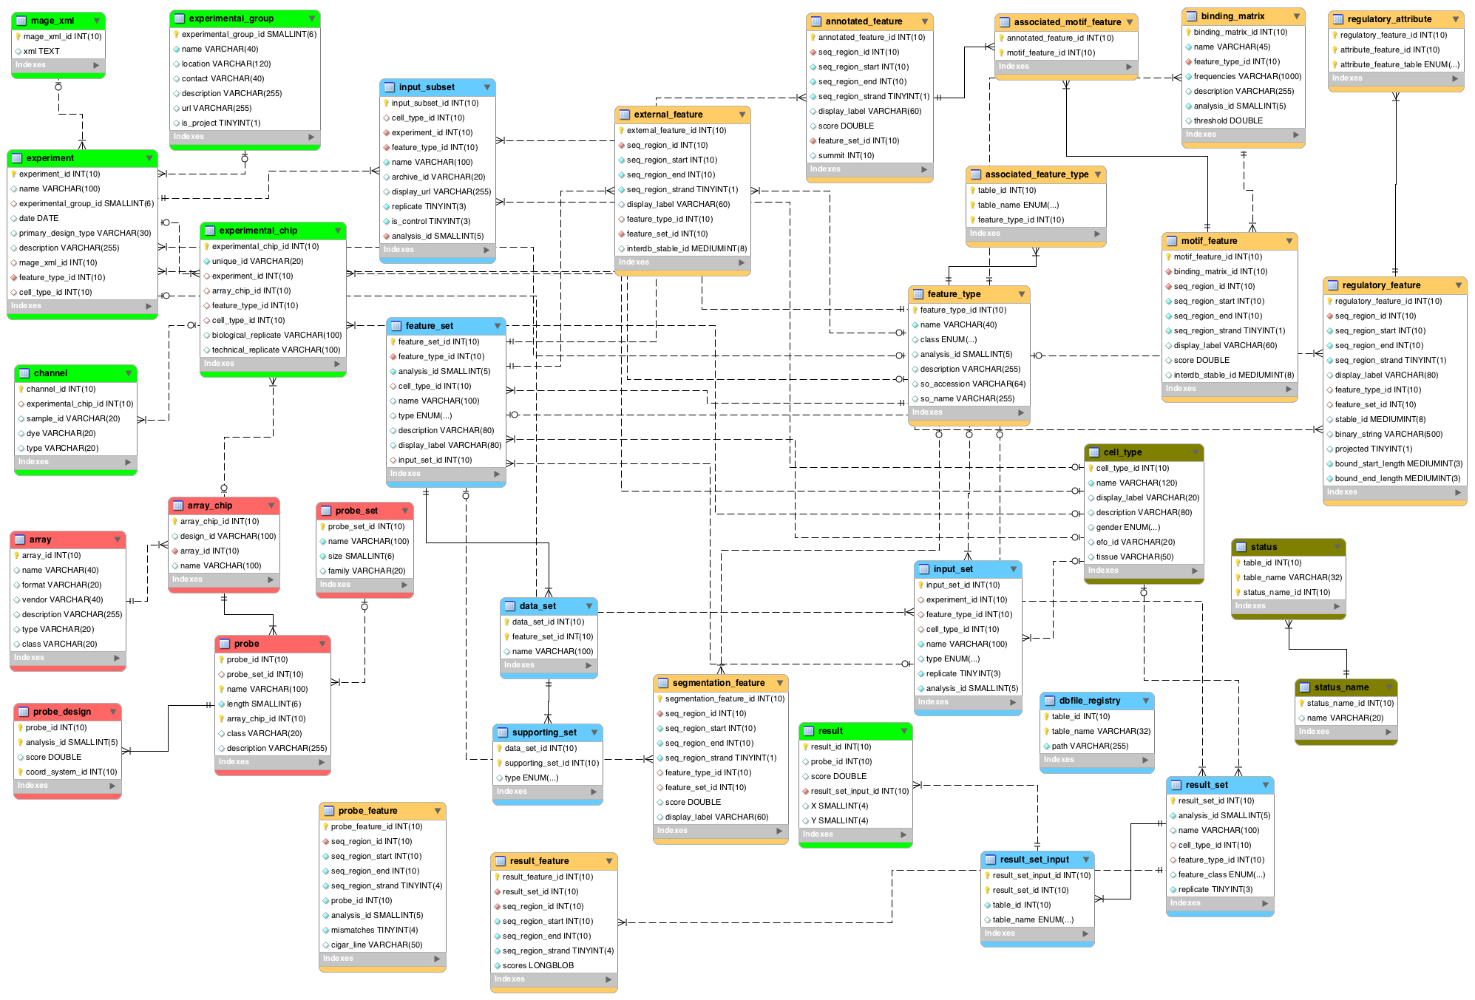
Funcgen DB Schema
http://www.ensembl.org/info/docs/api/funcgen/trimmed_funcgen_schema.png

Slide 29
Data Classes
Metadata
CellType, FeatureType
InputSubset
FASTQ files used in the alignments
ResultSet
Aligned reads from *-seq,…
FeatureSet
ChIP peaks (Annotated features)
FANTOM predictions (External features)
Regulatory Build (Regulatory features)
Features: Annotated, External, Motif, Regulatory, Segmentation
Notes:
Wont cover array data or raw/result data in this course. Focus on main ‘processed’ features.
29

Slide 30
API - Registry
use strict;
use warnings;
use Bio::EnsEMBL::Registry;
my $reg = 'Bio::EnsEMBL::Registry';
$reg->load_registry_from_db(
-host => 'ensembldb.ensembl.org',
-user => 'anonymous'
);
#Object adaptors create objects, hiding how they are stored
#An object adaptor (RegulatoryFeature Adaptor)
my $rfa =
$reg->get_adaptor('human','funcgen','regulatoryfeature');
species
team
object
Notes:
use strict;
use warnings;
use Bio::EnsEMBL::Registry;
my $reg = 'Bio::EnsEMBL::Registry';
$reg->load_registry_from_db(
-host => 'ensembldb.ensembl.org',
-user => 'anonymous'
);
#Object adaptors create objects, hiding how they are stored
#An object adaptor (RegulatoryFeature Adaptor)
my $rfa = $reg->get_adaptor('human','funcgen','regulatoryfeature');
30

Slide 31
API - Object Adaptors
Meta data
$cta = $reg->get_adaptor('human', 'funcgen', 'celltype');
$fta = $reg->get_adaptor('human', 'funcgen', 'featuretype');
Sets
$dsa = $reg->get_adaptor('human', 'funcgen', 'dataset');
$fsa = $reg->get_adaptor('human', 'funcgen', 'featureset');
Features
$rfa = $reg->get_adaptor('human', 'funcgen','regulatoryfeature');
$afa = $reg->get_adaptor('human', 'funcgen','annotatedfeature');
$efa = $reg->get_adaptor('human', 'funcgen','externalfeature');
Alternative
$db = $reg->getDBAdaptor('human', 'funcgen');
$fsa = $db->get_FeatureSetAdaptor;
Notes:
#Meta data
my $cta = $reg->get_adaptor('human', 'funcgen', 'celltype');
my $fta = $reg->get_adaptor('human', 'funcgen', 'featuretype');
#Sets
my $dsa = $reg->get_adaptor('human', 'funcgen', 'dataset');
my $fsa = $reg->get_adaptor('human', 'funcgen', 'featureset');
#Features
my $rfa = $reg->get_adaptor('human', 'funcgen', 'regulatoryfeature');
my $afa = $reg->get_adaptor('human', 'funcgen', 'annotatedfeature');
my $efa = $reg->get_adaptor('human', 'funcgen', 'externalfeature');
#Alternative
$db = $reg->getDBAdaptor('human', 'funcgen');
$fsa = $db->get_FeatureSetAdaptor;
31

Slide 32
CellType
Metadata associated to experiments
Access via CellTypeAdaptor
Key attributes:
Attribute | Example value(s) | Method(s)
name | HeLa-S3 CD4 | $ct->name
description | Human CD4 T-Cells | $ct->description
gender | male | $ct->gender
Notes:
Using the CellTypeAdaptor do something like fetch_by_name HeLa
32

Slide 33
FeatureType
Metadata associated with experiments
Describes type of genomic feature
Access via FeatureTypeAdaptor
Key attributes/methods:
Attribute | Example value(s) | Method(s)
name | H3K4me3, CTCF DNase1 | $ft->name
description | Histone 3 Lysine 4 Tri-Methylation | $ft->description
class | Histone Regulatory Feature | $ft->class
Notes:
Assay or experimental data that you are looking at, eg the antibody that has been used to pull down a specific feature.
Every Feature in the DB will have a Feature linked, but not necessarily a CellType
33

Slide 34
Analysis
Metadata associated to processed Features (Annotated, Result) or InputSubset
Describes type of analysis used to create Feature or analysis to be used (InputSubset)
Access via AnalysisAdaptor or via Feature
Key attributes/methods:
Attribute | Example value(s) | Method(s)
logic_name | SWEmbl_R0005_IDR, bwa_samse | $an->logic_name
parameters | -f 150 –R 0.015 | $an->parameters
program | SWEmbl | $an->program
Notes:
Assay or experimental data that you are looking at, eg the antibody that has been used to pull down a specific feature.
Every Feature in the DB will have a Feature linked, but not necessarily a CellType
34

Slide 35
Exercises
Metadata
1. Regulatory Features are areas in the genome associatioted with regulatory activity. These activities are cell type specific.
For the cell "K562", print name, description, display_label, gender and efo_id
Hint: Use the doxygen documentation for CellType.
2. Regions in cell types are classified by their function, e.g. Promoter, Enhancer, Open Chromantin, Transcription Factor...
For the FeatureType "Promoter", print Name, Description, SO Accession and SO Name
Hint: Use the doxygen documentation for FeatureType
3. Now find out how many different "Transcription Factor" are available in human.
Hint: Look for a method in the FeatureTypeAdaptor that can be used to fetch data by its class.
4. Analysis are objects which describe programs (e.g. BLAST, bwa, ChIP-seq) used to analyse regions of the genome. The Analysis Object has not implemented from in Regulation, we use the Core Object.
Go to the Regulation Doxygen page. Using the search box, look for the AnalysisAdaptor. Which namespace is it located?
Write a script which fetches the analysis with the name "SWEmbl_R015_f150_d150".
Print program, program_version, program_file, parameters and module

Slide 36
AnnotatedFeature
Genomic location of a prediction of the ERSA [Ensembl Regulation Sequence Analysis] Pipeline
Used as evidence for Regulatory Features. Fetched via:
$regulatory_feature->regulatory_attributes(‘annotated’)
Method | Example value(s) | Code
display_label | CTCF – IMR90 Enriched Site | $af->display_label
score | Value | $af->score
summit | Coordinate | $af->summit
get_associated_MotifFeatures | List of MotifFeature objects | $af->get_associated_MotifFeatures
Notes:
Peak calls
Can be accessed via AF_adapter
Score: only consistent between a given set of features, can’t compare between different features
Summit = triangle, predicted summit
No motif feature here
Highlight associated motif method, see what PWM’s have been mapped.
36

Slide 37
RegulatoryFeature
Result of the Regulatory Build Process
Generic Bio::EnsEMBL::Feature methods:
(seq_region_)start/end, strand, slice etc…
Key attributes/methods:
Attribute | Example value(s) | Method(s)
FeatureType | Promoter Associated Gene Associated | $rf->feature_type->name
CellType | HeLa-S3 MultiCell | $rf->cell_type->name
Bound start/end | 5000 - 5800 | $rf->bound_start/end
Stable ID | ENSR00000000430 | $rf->stable_id
Regulatory Attributes | List of underlying supporting features | $rf->regulatory_attributes(‘annotated’)
Notes:
Reg Feat looks like this
Acess to all Bio Ens Feat methods,
More specific for Funcgen are FT and CT
Bound are whiskers, start/end are core
Regulatory Attributes are all the experimental evidence that went into building this feature.
This example passes the class annotated, which will return cjipseq and dnase peaks. Could also use motif. Omit returns everything
Standard Ensembl Feature, standard core methods can be used.
Annotated can be replaced by motif, or ommited and returns everything
37

Slide 38
RegulatoryFeatureAdaptor
Enables access to Regulatory Features:
By default it accesses MultiCell Regulatory Features
Key methods:
Methods | Example arguments | Result
fetch_all_by_Slice | Bio::EnsEMBL::Slice object | MultiCell Regulatory Features
fetch_by_stable_id | String ID: ‘ENSR00000000430’ | A MultiCell Regulatory Feature
fetch_all_by_stable_ID | String ID: ‘ENSR00000000430’ | MultiCell & Cell-specific Regulatory Features
fetch_all_by_Slice_FeatureSets | Bio::EnsEMBL::Slice Bio::EnsEMBL::Funcgen::FeatureSet | Regulatory Features specific to Slice and FeatureSets
Notes:
fetch_by_stable_id: Implemented by all adaptors which access stable Ensembl objects.
Beware: returns multiCell features as cell type specific features at the same location share the same stable id.
Extra method fetch_all_by_stable_id which returns all.
38

Slide 39
Example: MultiCell Regulatory Features
# fetch_all_by_slice retrieves a list of MultiCell Features on a given Slice.
my $regfeat_adaptor =
$reg->get_adaptor('human', 'funcgen', 'regulatoryfeature');
my $slice_adaptor =
$reg->get_adaptor('human', 'core', 'slice');
my $slice =
$slice_adaptor->fetch_by_region( 'chromosome',1, 54960000, 54980000 );
my @reg_feats = @{$regfeat_adaptor->fetch_all_by_Slice($slice)};
#These Features are global 'MultiCell' Regulatory Features.
foreach my $rf (@reg_feats){
say "Stable ID: " .$rf->stable_id;
say "\tLocation: ".$rf->seq_region_name . ":" .
$rf->seq_region_start."-".$rf->seq_region_end;
say "\tCell: " .$rf->cell_type->name;
say "\tFeature Type: ".$rf->feature_type->name;
}
Notes:
#!/usr/bin/perl
use strict;
use warnings;
use Bio::EnsEMBL::Registry;
use feature qw(say);
my $registry = 'Bio::EnsEMBL::Registry';
$registry->load_registry_from_db(
-host => 'ensembldb.ensembl.org',
-user => 'anonymous',
);
# fetch_all_by_slice retrieves a list of MultiCell Features on a given Slice.
my $regfeat_adaptor = $registry->get_adaptor('human', 'funcgen', 'RegulatoryFeature');
my $slice_adaptor = $registry->get_adaptor('human', 'core', 'Slice');
my $slice =
$slice_adaptor->fetch_by_region( 'chromosome',1, 54960000, 54980000 );
my @reg_feats = @{$regfeat_adaptor->fetch_all_by_Slice($slice)};
#These Features are global 'MultiCell' Regulatory Features.
foreach my $rf (@reg_feats){
say "Stable ID: " .$rf->stable_id;
say "\tLocation: ".$rf->seq_region_name . ":" .
$rf->seq_region_start."-".$rf->seq_region_end;
say "\tCell: " .$rf->cell_type->name;
say "\tFeature Type: ".$rf->feature_type->name;
}
39

Slide 40
Example: MultiCell Regulatory Features
Stable ID: ENSR00001580063
Location: 1:54959695-54960094
Cell: MultiCell
Feature Type: Enhancer
Stable ID: ENSR00001580064
Location: 1:54962980-54963053
Cell: MultiCell
Feature Type: TF binding site
Stable ID: ENSR00001520401
Location: 1:54965295-54968094
Cell: MultiCell
Feature Type: Promoter Flanking Region
Stable ID: ENSR00001580065
Location: 1:54969895-54970294
Cell: MultiCell
Feature Type: Enhancer
Stable ID: ENSR00000536956
Location: 1:54970695-54973894
Cell: MultiCell
Feature Type: Promoter Flanking Region
Stable ID: ENSR00001580066
Location: 1:54973095-54973694
Cell: MultiCell
Feature Type: CTCF Binding Site
Stable ID: ENSR00001580067
Location: 1:54977895-54978494
Cell: MultiCell
Feature Type: Enhancer
Notes:
# fetch_all_by_slice retrieves a list of MultiCell Features on a given Slice.
my $regfeat_adaptor = $reg->get_adaptor('Human', 'funcgen', 'regulatoryfeature');
my $slice = $slice_adaptor->fetch_by_region( 'chromosome’,1,54960000, 54980000 );
my @reg_feats = @{$regfeat_adaptor->fetch_all_by_Slice($slice)};
#These Features are global 'MultiCell' Regulatory Features.
foreach my $rf (@reg_feats){
print "Stable ID: ".$rf->stable_id."\n";
print "\tLocation: ".$rf->seq_region_name.":".
$rf->seq_region_start."-".$rf->seq_region_end."\n";
print "\tCell: ".$rf->cell_type->name."\n";
print "\tFeature Type: ".$rf->feature_type->name."\n";
}
40

Slide 41
Example: Cell-specific RegulatoryFeature details
my $rfs =
$regfeat_adaptor->fetch_all_by_stable_ID('ENSR00000165384');
foreach my $cell_rf (@{$rfs}){
#The stable id will always be 'ENSR00000165384'
print $cell_rf->stable_id.": \n";
#But now it will be for a specific cell type
print "\tCell: ".$cell_rf->cell_type->name."\n";
#It will also contain cell-specific annotation
print "\tType: ".$cell_rf->feature_type->name."\n";
#And cell-specific extra boundaries
print "\t".$cell_rf->seq_region_name.":".
$cell_rf->bound_start."..".$cell_rf->start."-".
$cell_rf->end."..". $cell_rf->bound_end."\n";
}
Notes:
# fetch_all_by_stable_id retrieves a list of RegulatoryFeatures associated with this ID, one for each CellType
# as cell type specific features at the same location share the same stable id.
# Core region is shared
my $rfs =
$regfeat_adaptor->fetch_all_by_stable_ID('ENSR00000165384');
foreach my $cell_rf (@{$rfs}){
#The stable id will always be 'ENSR00000165384'
print $cell_rf->stable_id.": \n";
#But now it will be for a specific cell type
print "\tCell: ".$cell_rf->cell_type->name."\n";
#It will also contain cell-specific annotation
print "\tType: ".$cell_rf->feature_type->name."\n";
#And cell-specific extra boundaries
print "\t".$cell_rf->seq_region_name.":".
$cell_rf->bound_start."..".$cell_rf->start."-".
$cell_rf->end."..". $cell_rf->bound_end."\n";
}
41

Slide 42
Example: Cell-specific RegulatoryFeature details
ENSR00000165384:
Cell: Monocytes-CD14+
Type: Promoter Flanking Region
1:54498695..54498695-54500094..54500094
ENSR00000165384:
Cell: A549
Type: Promoter Flanking Region
1:54498695..54498695-54500094..54500094
ENSR00000165384:
Cell: HUVEC
Type: Promoter Flanking Region
1:54498695..54498695-54500094..54500094
ENSR00000165384:
Cell: HMEC
Type: Promoter Flanking Region
1:54498695..54498695-54500094..54500094
ENSR00000165384:
Cell: NHLF
Type: Promoter Flanking Region
1:54498695..54498695-54500094..54500094
ENSR00000165384:
Cell: HSMMtube
Type: Promoter Flanking Region
1:54498695..54498695-54500094..54500094
ENSR00000165384:
Cell: MultiCell
Type: Promoter Flanking Region
1:54498695..54498695-54500094..54500094
ENSR00000165384:
Cell: DND-41
Type: Promoter Flanking Region
1:54498695..54498695-54500094..54500094
Notes:
# fetch_all_by_stable_id retrieves a list of RegulatoryFeatures associated with this ID, one for each CellType
# as cell type specific features at the same location share the same stable id.
# Core region is shared
my $rfs =
$regfeat_adaptor->fetch_all_by_stable_ID('ENSR00000165384');
foreach my $cell_rf (@{$rfs}){
#The stable id will always be 'ENSR00000165384'
print $cell_rf->stable_id.": \n";
#But now it will be for a specific cell type
print "\tCell: ".$cell_rf->cell_type->name."\n";
#It will also contain cell-specific annotation
print "\tType: ".$cell_rf->feature_type->name."\n";
#And cell-specific extra boundaries
print "\t".$cell_rf->seq_region_name.":".
$cell_rf->bound_start."..".$cell_rf->start."-".
$cell_rf->end."..". $cell_rf->bound_end."\n";
}
42

Slide 43
Example: What AnnotatedFeatures support this RegulatoryFeature?
#This gets the 'MultiCell' Regulatory Feature
my $rf =
$regfeat_adaptor->fetch_by_stable_id('');
my @annotated_features =
@{$rf->regulatory_attributes('annotated')};
#Get annotated features supporting a regulatory feature
foreach my $annotated_feature (@annotated_features) {
print $annotated_feature->display_label."\t";
print $annotated_feature->score."\t";
say $annotated_feature->summit;
}
Notes:
#!/usr/bin/perl
use strict;
use warnings;
use Bio::EnsEMBL::Registry;
use feature qw(say);
my $registry = 'Bio::EnsEMBL::Registry';
$registry->load_registry_from_db(
-host => 'ensembldb.ensembl.org',
-user => 'anonymous',
);
my $regfeat_adaptor = $registry->get_adaptor('human', 'funcgen', 'RegulatoryFeature');
#This gets the 'MultiCell' Regulatory Feature
my $rf =
$regfeat_adaptor->fetch_by_stable_id('ENSR00000165384');
my @annotated_features =
@{$rf->regulatory_attributes('annotated')};
#Get annotated features supporting a regulatory feature
foreach my $annotated_feature (@annotated_features) {
print $annotated_feature->display_label."\t";
print $annotated_feature->score."\t";
say $annotated_feature->summit;
}
43

Slide 44
Example: What AnnotatedFeatures support this RegulatoryFeature?
DNase1 - HUVEC Enriched Site 40.489637 54965202
DNase1 - K562 Enriched Site 27.862417 54965209
DNase1 - H1ESC Enriched Site 26.207104 54965236
CTCF - HUVEC Enriched Site 125.020915 54965284
DNase1 - HSMM Enriched Site 17.812017 54965234
DNase1 - H1ESC Enriched Site 107.692877 54965254
CTCF - HMEC Enriched Site 84.500112 54965296
CTCF - CD4 Enriched Site 12.242441 54965282
CTCF - HepG2 Enriched Site 36.243751 54965285
CTCF - NHEK Enriched Site 156.68494 54965300
DNase1 - K562 Enriched Site 19.889997 54965289
CTCF - HUVEC Enriched Site 47.901836 54965291
Rad21 - K562 Enriched Site 33.054809 54965299
CTCF - K562 Enriched Site 29.488397 54965300
CTCF - NHEK Enriched Site 21.50665 54965304
CTCF - H1ESC Enriched Site 22.526458 54965314
CTCF - NHEK Enriched Site 84.547054 54965322
CTCF - K562 Enriched Site 85.822038 54965326
DNase1 - NHEK Enriched Site 26.878816 54965373
DNase1 - HepG2 Enriched Site 17.995201 54965390
Notes:
#This gets the 'MultiCell' Regulatory Feature
my $rf =
$regfeat_adaptor->fetch_by_stable_id('ENSR00000165384');
my @annotated_features =
@{$rf->regulatory_attributes('annotated')};
#Get annotated features supporting a regulatory feature
foreach my $annotated_feature (@annotated_features) {
print $annotated_feature->display_label."\n";
print $annotated_feature->score."\n";
print $annotated_feature->summit."\n";
}
44

Slide 45
Exercise: Regulatory Features
Regulatory Features
Regulatory Features are regions in the genome for which there is some experimental evidence indicating a potential role in the regulation of gene expression.
1. Regulatory Features: cell type specific data
Using the human DB, fetch the all the cell type specific regulatory features with stable ID 'ENSR00000054736'.
Print out the stable ID, bound_start/end and start/end values, name of the cell and feature type for each.
HINT: To get all the cell type specific RegulatoryFeatures use the fetch_all_by_stable_ID method from the RegulatoryFeatureAdaptor.
General information about Ensembl stable IDs
2. Regulatory Features: What RegulatoryFeatures are near the oncogene BRCA2?
Create a script which fetches all the RegulatoryFeatures within 1KB of the BRCA2 gene.
Print out their stable IDs, bound_start/end and start/end values, name of the cell and feature types.
HINT: Use fetch_all_by_external_name with 'BRCA2' to get the gene object from the core API. This will return a copy of the gene on a chromosome and on an LRG. Use the following code to grab the right one: my $gene = (grep {$_->slice->coord_system_name eq 'chromosome'} @genes )[0];
HINT: Look at the arguments for fetch_by_gene_stable_id, or use the Gene->feature_Slice method and Slice->expand methods.

Slide 46
Exercise: Regulatory Features
3. Regulatory Features: associated experimental evidence
Now fetch just the ENSR00000054736 MultiCell feature.
Print out the display_label, start/end values of all the underlying supporting (evidence) features.
What is the type of the evidence feature?
Compare with the start/end values of the regulatory feature itself.
HINT: By default the fetch_by_stable_id method returns just the MultiCell features.
HINT: Use the Perl ref function to find the type of the supporting features
4. Annotated Features
Annotated Features represent the genomic location of a ERSA prediction. These correspond to regions in the genome enriched for specific events (e.g. TF binding or Histone Marks) aka 'peak calls'.
Fetch the AnnotatedFeatures in the region Y:5000000-40000000 for the Human FeatureSets with name: K562_DNase1_ENCODE_Duke_SWEmbl_R0005_IDR HepG2_DNase1_ENCODE_Duke_SWEmbl_R0005_IDR
Print the number of features returned by each, the details of the CellType (e.g. gender) associated with the FeatureSet and the details of the few features including the 'summit'.
What are the differences and why?
Optional: Print the properties(logic_name, display_label, parameters) of the Analysis.

Slide 47
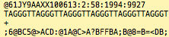
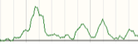
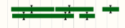
Bio::EnsEMBL::Funcgen Sets
InputSubset
ResultSet
FeatureSet
Sequence
Alignement
Peaks
Experiment
Notes:
Raw chip seq alignement, imported as ResultSet, incoperated into the Database as a SupportingSet
Peaks are cell type specific.
DataSet1: Core region, focus features
DataSet2: Attribute region, whiskers
DataSet3: Output, regulatory feature
Very flexible.
47

Slide 48
InputSubset
Distinct input, e.g. FASTQ file
Describes File
Access via InputSubsetAdaptor
Has Analysis, CellType and FeatureType attached
Key attributes/methods:
Attribute | Example value(s) | Method(s)
name | wgEncodeBroadHistoneGm12878CtcfStdRawDataRep2 | $iss->name
replicate | 1 2 | $iss->replicate
is_control | 0 1 | $iss->is_control
Notes:
Assay or experimental data that you are looking at, eg the antibody that has been used to pull down a specific feature.
Every Feature in the DB will have a Feature linked, but not necessarily a CellType
48

Slide 49
ResultSet
Provides access to the alignment data
Key attributes/methods:
Attribute | Example value(s) | Method(s)
Name | GM12878_CTCF_ENCODE_Broad_bwa_samse | $rs->name
Analysis | Analysis Object | $rs->analysis->logic_name
Support | List of supporting InputSubset objects | $rs->get_support
Notes:
49

Slide 50
FeatureSet
Processed Feature container:
Regulatory, Annotated, External, Segmentation
Key attributes/methods:
Attributes | Example value(s) | Method(s)
Name | GM12878_CTCF_ENCODE_Broad_SWEmbl_R0005_IDR | $fs->name
Display label | CTCF - GM12878 enriched sites | $fs->display_label
Cell Type (*) | GM12878 | $fs->cell_type->name (*)
Feature Type | CTCF | $fs->feature_type->name
Features | List of Features e.g. Annotated or RegulatoryFeatures | $fs->get_all_Features
* : Some Feature Sets may not have metadata like cell type
Notes:
Some External FeatureSets might not have cell types
50

Slide 51
FeatureSetAdaptor
Provides fetch methods for FeatureSet objects
Methods | Example arguments
fetch_by_name | GM12878_CTCF_ENCODE_Broad_SWEmbl_R0005_IDR
fetch_all_by_CellType | CellType obect
fetch_all_by_FeatureType | FeatureType object
fetch_all_by_feature_class | external, annotated or regulatory

Slide 52
Example: Get all TFBS FeatureSets
my $fset_adaptor =
$reg->get_adaptor('Human', 'funcgen', 'featureset');
my $ftype_adaptor =
$reg->get_adaptor('Human', 'funcgen', 'featuretype');
my @tfs =
@{$ftype_adaptor->fetch_all_by_class('Transcription Factor')};
foreach my $ft (@tfs){
my @fsets = @{$fset_adaptor->fetch_all_by_FeatureType($ft)};
print "Found ".scalar(@fsets).' '.$ft->name." FeatureSets:\n";
foreach my $fset (@fsets){
say "\t".$fset->name;
say "\t\tCellType: ".$fset->cell_type->name;
say "\t\tFeatureType: ".$fset->feature_type->name;
say "\t\tAnalysis: ".$fset->analysis->logic_name;
}
}
Notes:
#!/usr/bin/perl
use strict;
use warnings;
use Bio::EnsEMBL::Registry;
use feature qw(say);
my $registry = 'Bio::EnsEMBL::Registry';
$registry->load_registry_from_db(
-host => 'ensembldb.ensembl.org',
-user => 'anonymous'
);
my $fset_adaptor =
$registry->get_adaptor('Human', 'funcgen', 'featureset');
my $ftype_adaptor =
$registry->get_adaptor('Human', 'funcgen', 'featuretype');
my @tfs =
@{$ftype_adaptor->fetch_all_by_class('Transcription Factor')};
foreach my $ft (@tfs){
my @fsets = @{$fset_adaptor->fetch_all_by_FeatureType($ft)};
next if(scalar (@fsets) == 0);
print "Found ".scalar(@fsets).' '.$ft->name." FeatureSets:\n";
foreach my $fset (@fsets){
say "\t".$fset->name;
say "\t\tCellType: ".$fset->cell_type->name;
say "\t\tFeatureType: ".$fset->feature_type->name;
say "\t\tAnalysis: ".$fset->analysis->logic_name;
my @af = @{$fset->get_all_Features};
say "\t\tAnnotatedFeatures: ".scalar(@af);
}
}
52

Slide 53
Example: Get all TFBS FeatureSets
Found 28 CTCF FeatureSets:
Found 34 CTCF FeatureSets:
HMEC_CTCF_ENCODE_Uw_SWEmbl_R015
CellType: HMEC
FeatureType: CTCF
Analysis: SWEmbl_R015
HUVEC_CTCF_ENCODE_Uta_SWEmbl_R0005_IDR
CellType: HUVEC
FeatureType: CTCF
Analysis: SWEmbl_R0005_IDR
[...]
Found 4 Cfos FeatureSets:
GM12878_Cfos_ENCODE_Yale_SWEmbl_R0005_IDR
CellType: GM12878
FeatureType: Cfos
Analysis: SWEmbl_R0005_IDR
Notes:
#!/usr/bin/perl
use strict;
use warnings;
use Bio::EnsEMBL::Registry;
use feature qw(say);
my $registry = 'Bio::EnsEMBL::Registry';
$registry->load_registry_from_db(
-host => 'ensembldb.ensembl.org',
-user => 'anonymous'
);
my $fsa = $registry->get_adaptor('Human', 'funcgen', 'featureset');
my $fset_adaptor =
$registry->get_adaptor('Human', 'funcgen', 'featureset');
my $ftype_adaptor =
$registry->get_adaptor('Human', 'funcgen', 'featuretype');
my @tfs =
@{$ftype_adaptor->fetch_all_by_class('Transcription Factor')};
foreach my $ft (@tfs){
my @fsets = @{$fset_adaptor->fetch_all_by_FeatureType($ft)};
next if(scalar (@fsets) == 0);
print "Found ".scalar(@fsets).' '.$ft->name." FeatureSets:\n";
foreach my $fset (@fsets){
say "\t".$fset->name;
say "\t\tCellType: ".$fset->cell_type->name;
say "\t\tFeatureType: ".$fset->feature_type->name;
say "\t\tAnalysis: ".$fset->analysis->logic_name;
my @af = @{$fset->get_all_Features};
say "\t\tAnnotatedFeatures: ".scalar(@af);
}
}
53

Slide 54
Exercise: Set questions
1. InputSubets
An InputSubset represents a individual, distinct input, usually a single file.
Using the InputSubsetAdaptor, fetch all InputSubsets which are linked to the FeatureType "CTCF".
Print Name, the name of the linked CellType and FeatureType, and the name of the Analysis used to process it.
2. ResultSets
ResultSets are the results of a sequence alignment.
Using the ResultSetAdaptor, fetch all ResultsSets which are linked to the Experiment "NHLF_H3K9ac_ENCODE_Broad"
print Name, CellType, FeatureType, Analysis and FilePath
3. FeatureSets
Feature Sets hold processed data or features i.e. peak calls or the output of a high level analysis e.g. the Regulatory Build.
Print the name of the feature sets for the Human 'GM12878' cell type.
Print the name of the feature sets for the Human 'CTCF' feature type.

Slide 55
MotifFeature
BindingMatrix (PWM) match
Also inherits generic Feature methods (eg. seq)
Fetched via:
$regulatory_feature->regulatory_attributes(‘motif’)
$annotated_feature->get_associated_MotifFeatures()
Some Key attributes / methods:
Method | Example value(s) | Code
display_label | Egr1:PB0010.1 | $mf->display_label()
binding_matrix | MA0060.1 | $mf->binding_matrix->name()
score | 0.81 | $mf->score()
associated_annotated_features | List of AnnotatedFeature objects | $mf->associated_annotated_features()
Notes:
associated_annotated_features -> complement
Binding_matirix returns an object
55

Slide 56
Example: What MotifFeatures support this RegulatoryFeature?
#This gets the 'MultiCell' Regulatory Feature
my $rf =
$regfeat_adaptor->fetch_by_stable_id('ENSR00000165384');
my @motif_features = @{$rf->regulatory_attributes('motif')};
#Get motif features supporting a regulatory feature
foreach my $motif_feature (@motif_features) {
print $motif_feature->display_label."\t";
print $motif_feature->binding_matrix->name."\t";
say $motif_feature->score;
foreach my $ann_feat
(@{$motif_feature->associated_annotated_features()}) {
print $ann_feat->display_label."\t";
print $ann_feat->score."\t";
say $ann_feat->summit;
}
}
Notes:
#!/usr/bin/perl
use strict;
use warnings;
use Bio::EnsEMBL::Registry;
use feature qw(say);
my $registry = 'Bio::EnsEMBL::Registry';
$registry->load_registry_from_db(
-host => 'ensembldb.ensembl.org',
-user => 'anonymous'
);
my $regfeat_adaptor =
$registry->get_adaptor('Human', 'funcgen', 'RegulatoryFeature');
my $rf =
$regfeat_adaptor->fetch_by_stable_id('ENSR00000165384');
my @motif_features = @{$rf->regulatory_attributes('motif')};
#Get motif features supporting a regulatory feature
foreach my $motif_feature (@motif_features) {
print $motif_feature->display_label."\t";
print $motif_feature->binding_matrix->name."\t";
say $motif_feature->score;
foreach my $ann_feat
(@{$motif_feature->associated_annotated_features()}) {
print $ann_feat->display_label."\t";
print $ann_feat->score."\t";
say $ann_feat->summit;
}
}
56

Slide 57
Example: What MotifFeatures support this RegulatoryFeature?
CTCF:MA0139.1 MA0139.1 9.038
CTCF - NHEK Enriched Site 150.010163 54499627
CTCF - DND-41 Enriched Site 132.989512 54499618
CTCF - IMR90 Enriched Site 71.36667 54499614
CTCF - HUVEC Enriched Site 50.439383 54499619
CTCF - K562 Enriched Site 71.237313 54499646
CTCF - HMEC Enriched Site 84.259496 54499624
CTCF - HepG2 Enriched Site 43.670844 54499612
CTCF - K562 Enriched Site 57.472107 54499619
CTCF - H1ESC Enriched Site 63.679699 54499606
CTCF - H1ESC Enriched Site 22.483645 54499642
CTCF - NHEK Enriched Site 58.775033 54499647

Slide 58
Motif Feature Exercises
1. Motif Features
Motif features represent putative binding sites based on alignments of PWMs from JASPAR. MotifFeatures are always associated to AnnotatedFeatures representing Transcription Factor (TF) Binding. More information about how we integrate these into the regulatory build process can be found here.
Get the 'motif' regulatory attributes associated to the Human Regulatory Feature 'ENSR00001227187'. Print their properties. Hint: use 'motif' as a parameter for regulatory_attributes.
Print the properties of the annotated features associated to the motif feature.
2. Binding Matrices and motif strength
Each MotifFeature is associated with a PWM, which are represented by the 'BindingMatrix' class. The MotifFeature score represents the relative binding affinity with respect to the PWM defined in the BindingMatrix.
Using the Motif feature obtained in exercise 2, get the associated Binding Matrix and print some details.
Check potential effect of changes in the sequence of the motif feature on the relative strength of that motif feature.

Slide 59
ExternalFeature
Externally curated: cisRED, miRanda, VISTA enhancers
Associated to Gene/Transcript through DBEntries
Key attributes/methods:
Method | Example value(s) | Code
Display label | craHsap66411 | $ef->display_label
Feature Type | cisRED Motif | $ef->feature_type->name
Xref methods | List of DBEntry object | $ef->get_all_Transcript_DBEntries $ef->get_all_Gene_DBEntries
Notes:
Xref method:
59

Slide 60
External Feature Exercise
External Features
The funcgen DB contains some data directly imported from external sources, like predicted miRNA targets from TarBase or experimentally verified regulatory regions from EnhancerDB
Create a script which gets all the 'TarBase miRNA' features for the Human region 7:32000000-34000000.
List their display_labels.
List all active regions from EnhancerDB ('VISTA enhancer set') for Human chromosome 7.
HINT: Use the feature_type to find out more information about a given feature e.g. which ones are active?

Slide 61
Getting More Information
Funcgen API tutorial – including microarray annotations http://www.ensembl.org/info/docs/api/funcgen/regulation_tutorial.html
Funcgen overview: http://www.ensembl.org/info/docs/api/funcgen/index.html
Regulatory Build info: http://www.ensembl.org/info/docs/funcgen/index.html
Experimental Data Sources http://www.ensembl.org/Homo_sapiens/Experiment?db=core;ex=all
helpdesk@ensembl.org
dev@ensembl.org
Notes:
Add DB schema here!
61

Slide 62

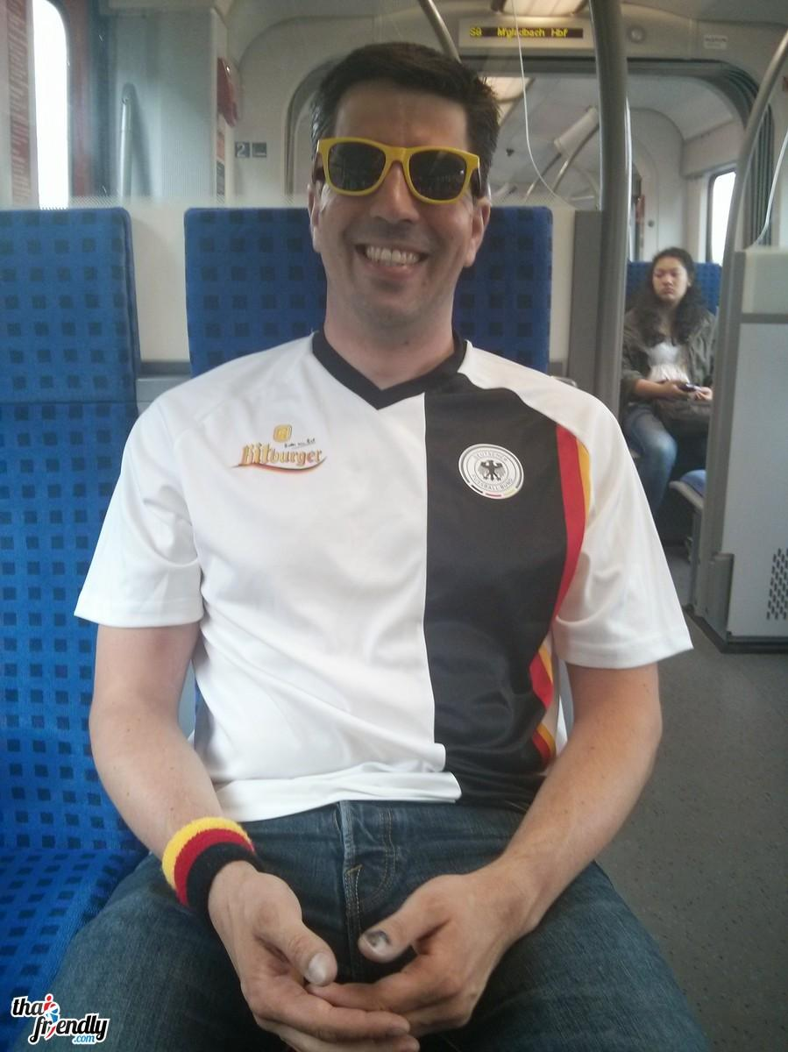
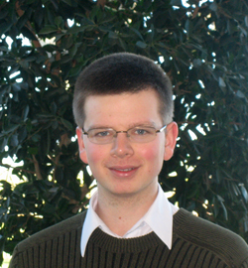


Ensembl Regulation Team
Daniel Zerbino
- Fearless Leader -
Thomas Juettemann
- Housekeeper -
Steve Wilder
- Master of Coin -
Ilias Lavidas
- Healer-
Michael Nuhn
- Pied Piper -

Slide 63
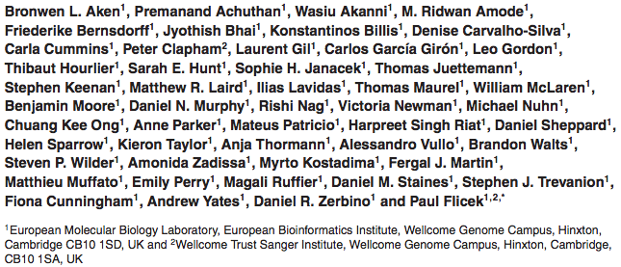








Ensembl Acknowledgements
The Entire Ensembl Team
Funding
Co-funded by the European Union

Slide 64




Ensembl Acknowledgements
Ensembl
Funding
Daniel Zerbino
Myrto Kostadima
Thomas Juettemann
Ilias Lavidas
Michael Nuhn
Sanger DBA & systems
Paul Flicek and the Entire Ensembl Team
Co-funded by the European Union
Notes:
Updated November 2012
64

Slide 65
DNA methylation -> inactive
CH₃
CH₃
CH₃
CH₃
CH₃
CH₃
CH₃
CH₃
GGCGGGATTGCGCGTTAGATCGCGCGCTTATGCTAGCCGCGCTGATAGC
GGCGGGATTGCGCGTTAGATCGCGCGCTTATGCTAGCCGCGCTGATAGC
GCTATCAGCGCGGCTAGCATAAGCGCGCGATCTAACGCGCAATCCCGCC
CH₃
CH₃
CH₃
CH₃
CH₃
CH₃
CH₃
CH₃
Notes:
Hidden

Slide 66
Bisulfite sequencing
CH₃
CH₃
CH₃
GGCGGGATTGCGCGTTAGATCGCGCGCTTATGCTAGCCGCGCTGATAGC
CH₃
CH₃
Bisulfite treatment
GGUGGGATTGUGUGTTAGATCGCGCGUTTATGUTAGUCGCGUTGATAGC
Sequence and compare to reference
Notes:
Hidden

Slide 67
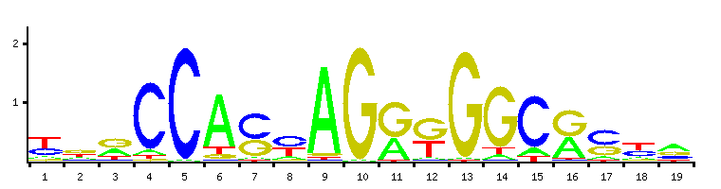
TF motifs vs ChIP-seq peaks
ChIP-seq sonication fragment 200 bases
CTCF binding motif – 19 bases
ATTTAGTTCCCTAGATCTGATCTAATCATCGGATCTATAGCCGATCGTAG
Read length 50 bases
peak
reads
DNA
19 bp
Motif
400 bp

Slide 68
Data source: ENCODE
Systematic analyses of transcription and regulatory mechanisms.
Started 2003
4,626 datasets, 2,498 cell types
http://www.nature.com/encode/#/threads
http://encodeproject.org

Slide 69

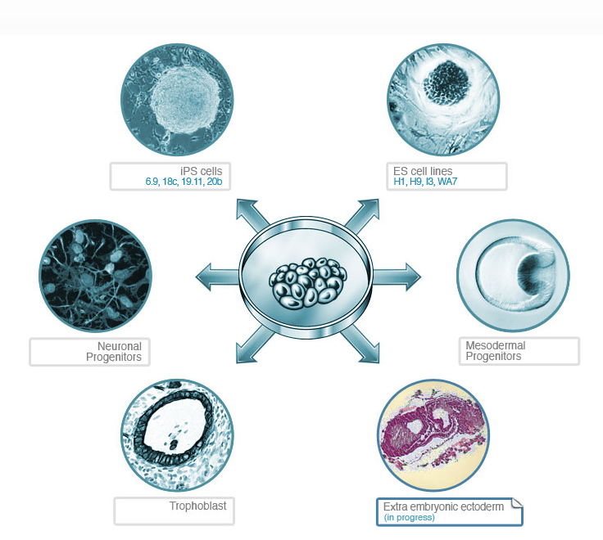
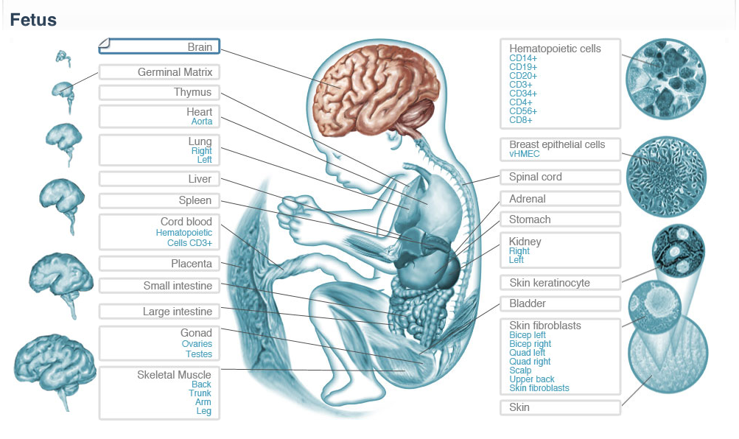
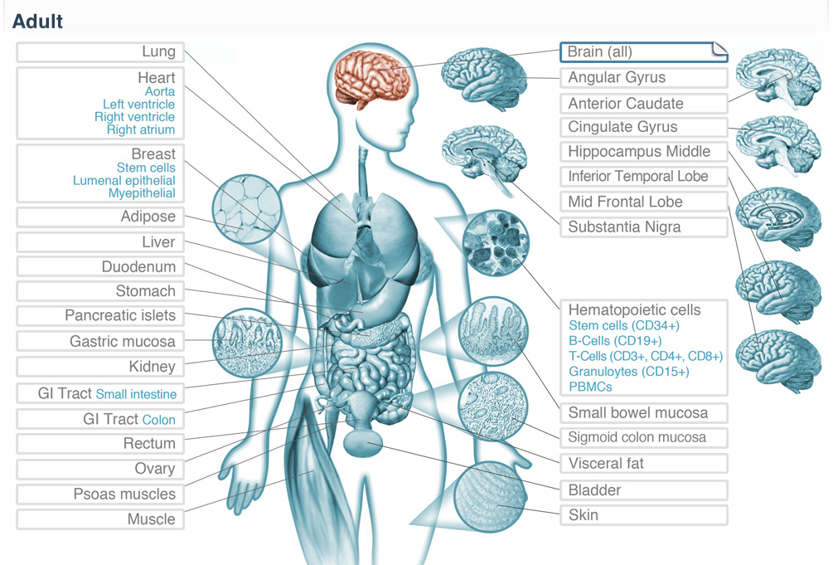
Data source: Roadmap (Finished)
NIH consortium: public resource of normal epigenomes
DNA methylation, histone marks, open chromatin, small RNA
http://www.roadmapepigenomics.org
Notes:
69

Slide 70

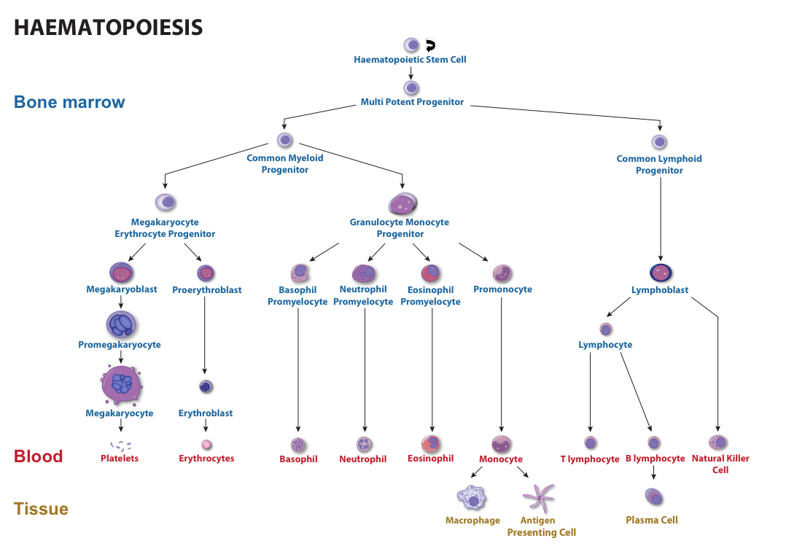
Data source: Blueprint
EU consortium: generate 100 reference epigenomes
Blood cells: healthy individuals and malignant leukaemic counterparts
http://www.blueprint-epigenome.eu/
Notes:
70

Slide 71
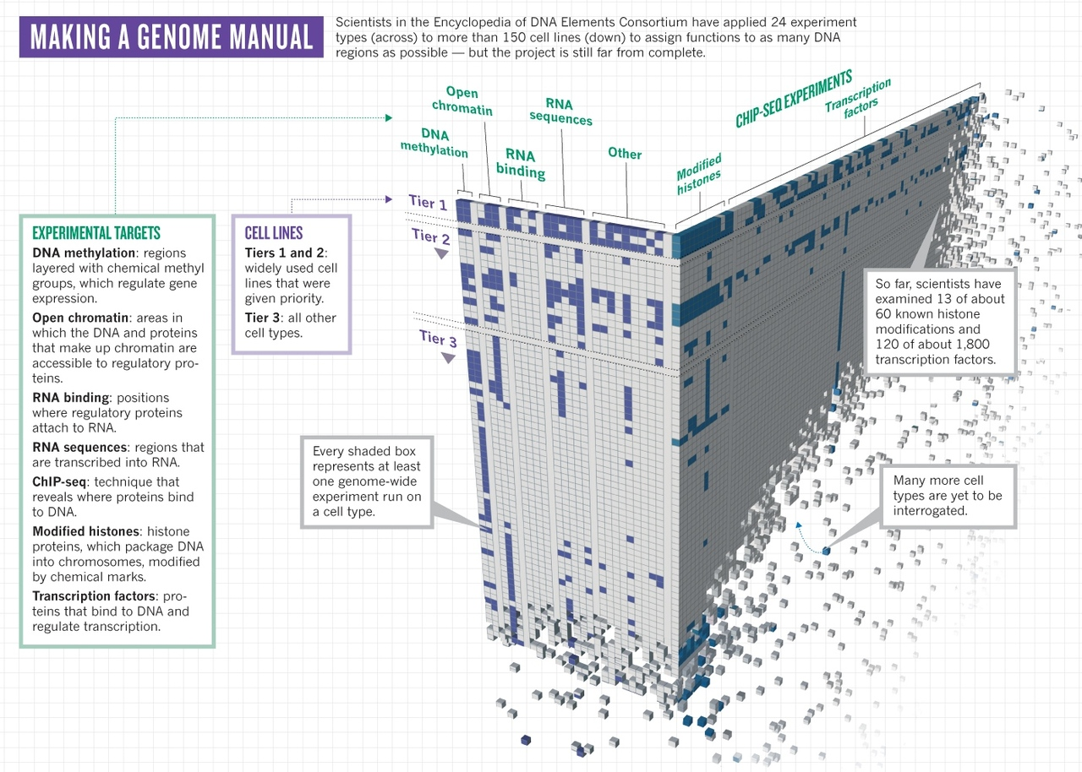



Available data
Notes:
Question: This looks like the research space is three dimensional, but it is actually two dimensional?
71

Slide 72
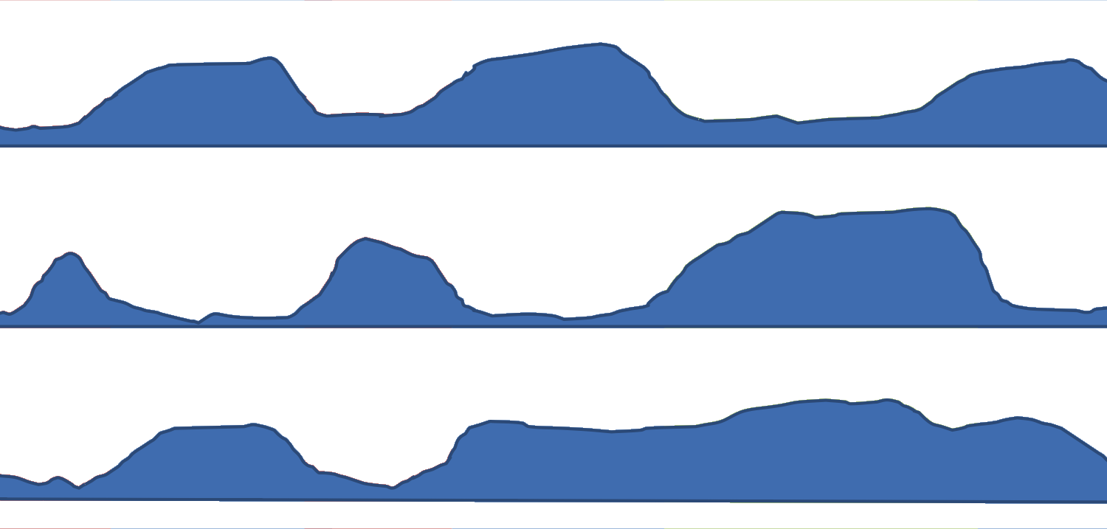
Genome Segmentation
Maximise similarity in labels
H3K27me3 (repressive mark)
DNaseI (open chromatin)
H3K4me1 (associated with enhancers)
72

Slide 73
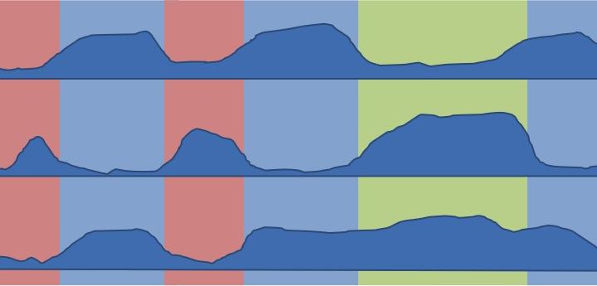
Genome Segmentation
Maximise similarity in labels
H3K27me3 (repressive mark)
DNaseI (open chromatin)
H3K4me1 (associated with enhancers)
73

Slide 74
Genome Segmentation
Maximise similarity in labels
H3K27me3 (repressive mark)
DNaseI (open chromatin)
Open
Repressed
Open
Repressed
Active enhancer
Repressed
H3K4me1 (associated with enhancers)
74

Slide 75
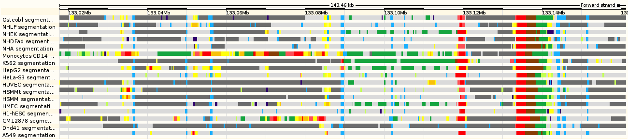
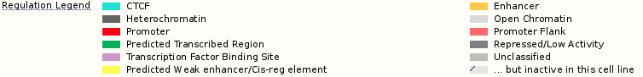
CTCF
Number of cells in CTCF states

Slide 76
Summarising TSS annotations
Number of cell types in promoter state

Slide 77
Ensembl Regulatory Build

Slide 78
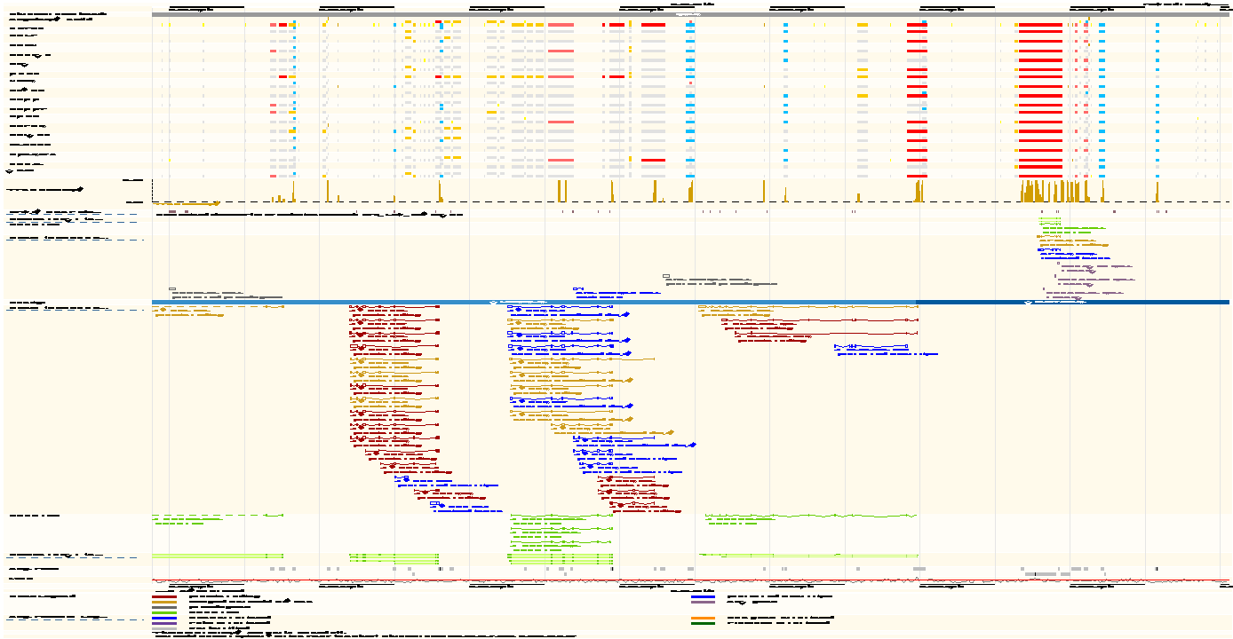
Ensembl Regulatory Build

